Slide 1

Emergency Responder Communications
Enhancement Systems (ERCES)
TFPA Meeting March 2023
siemens.com/smart-infrastructure
© Siemens 2023

Slide 2
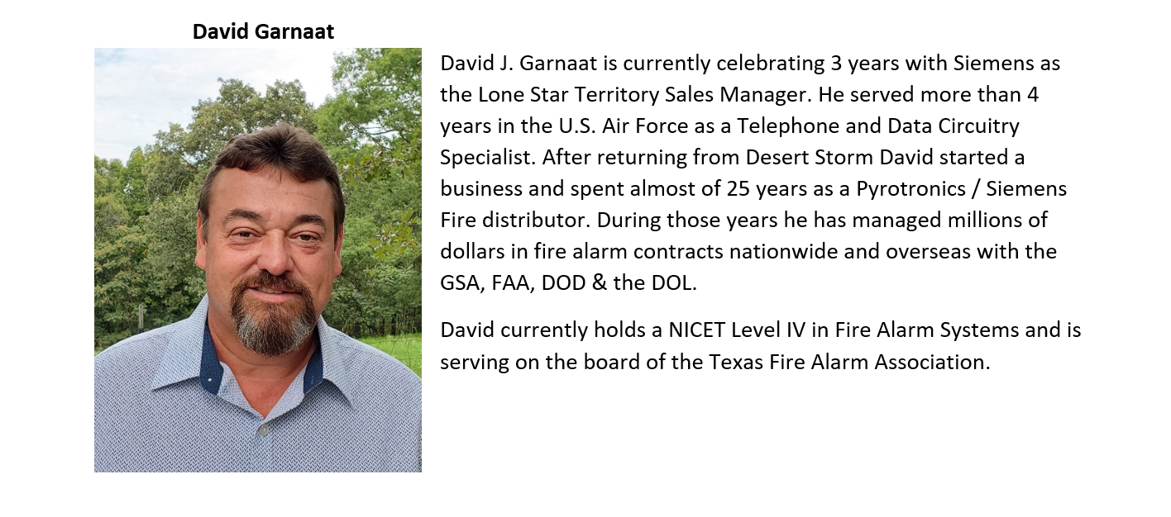


Slide 3
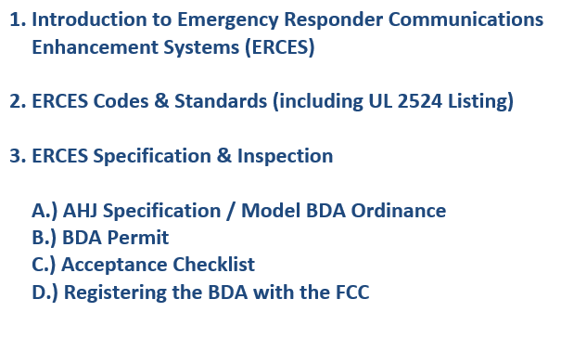
ERCES for the Texas Fire Protection Association
Notes:
Everyone assumes that radios will magically work in a school.
Reality is that radio signals get blocked by low-e glass, building materials, etc.
School Resource Officers / School Safety Officers rely on their 2-way radios
Building Codes require reliable in-building coverage, and the mean s that we use to ensure that emergency responders can coordinate their activities are Emergency Responder Radio Communication Enhancement Systems (ERRCES).

Slide 4


Slide 5
Trivia Question:
What is the name of the item in the following picture?

Slide 6
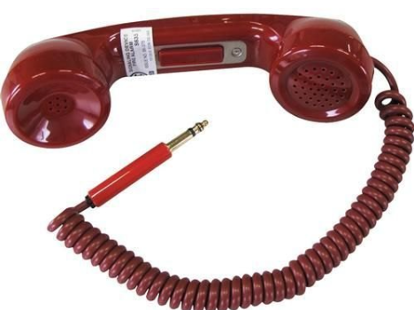

Slide 7
Answer:
Portable Firefighters Telephone Handset

Slide 8
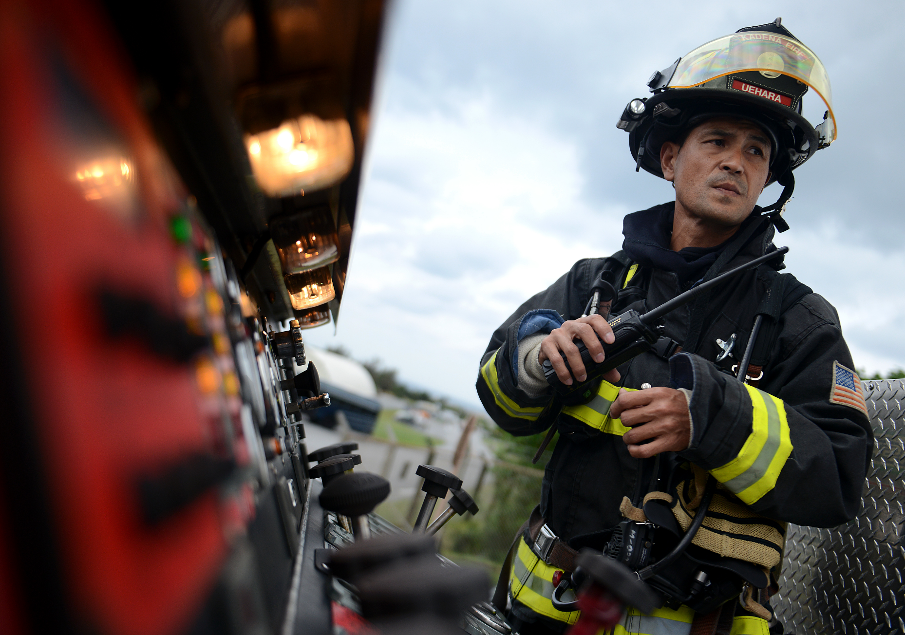

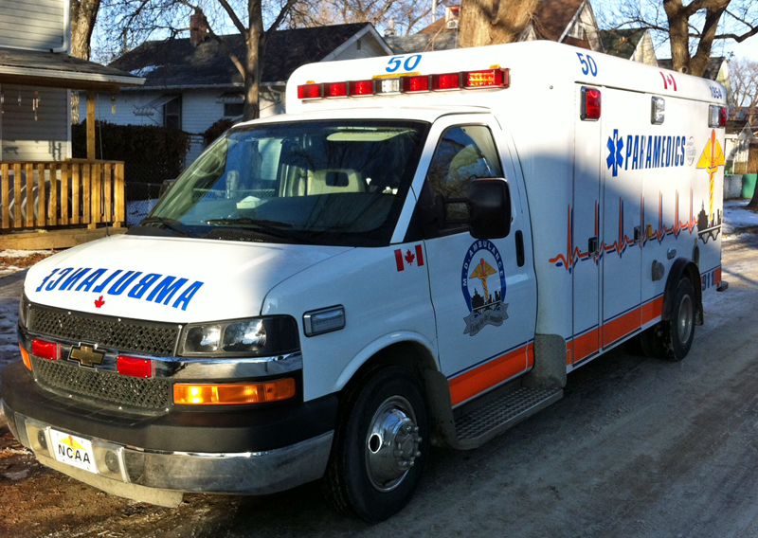
Public Safety Radio
  Reliable radio coverage is not a luxury. It is a necessity.
  Lives depend on it!
Notes:
The 2017 survey by IAFC of hundreds of respondents (fire, police & EMS) showed that they experienced RF Dead Spots during an emergency event 56% of the time in the last 2 years, and 31% in the last 6 months!

Slide 9
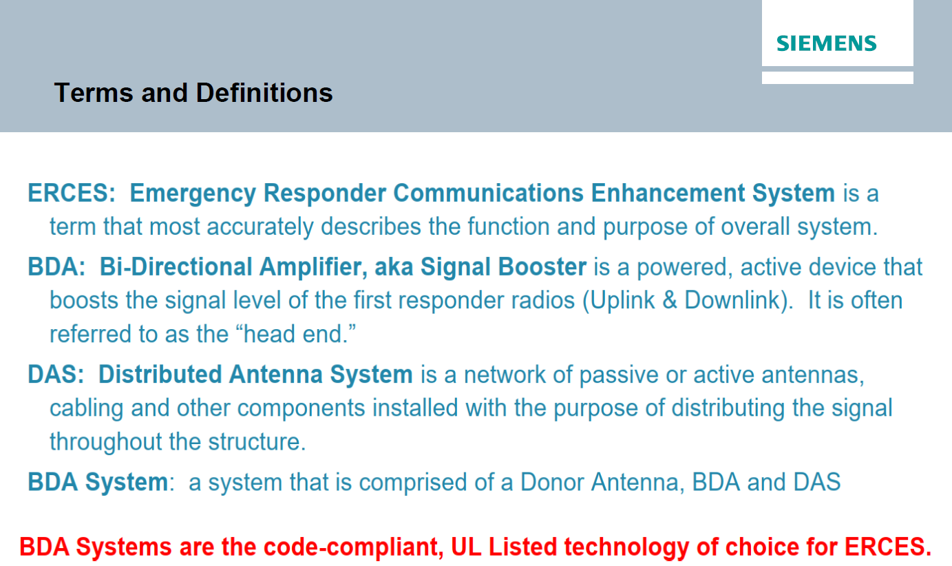

Slide 10
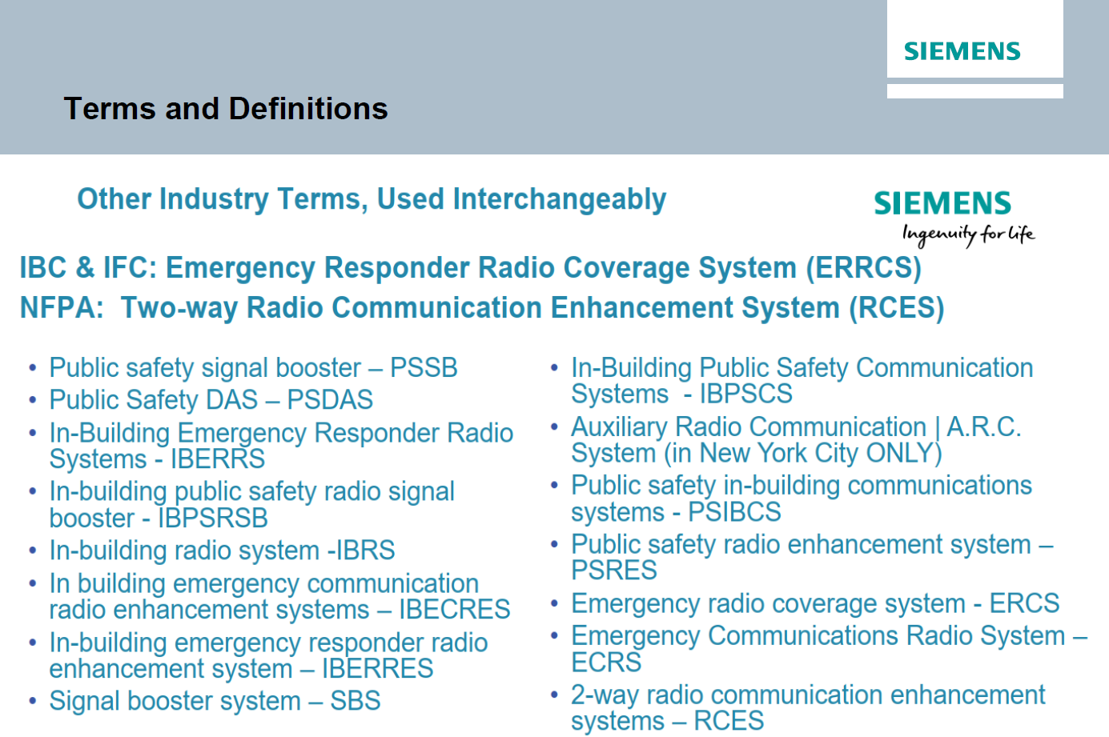

Slide 11
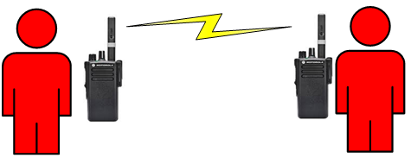
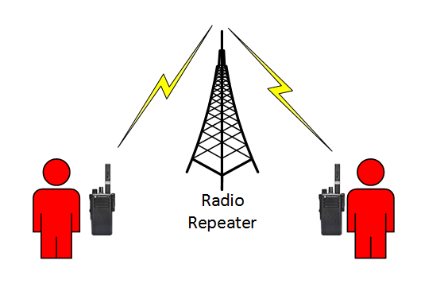
The Two Modes of Two-Way Radio Communications:
Direct Radio to Radio – aka “Simplex” Radio Communications where radios “talk” directly and there is no need for a central radio site.
Repeated, aka “duplex” frequency systems where all communications go through the repeater site. All transmissions are received and rebroadcasted with higher power by the repeater.

Slide 12
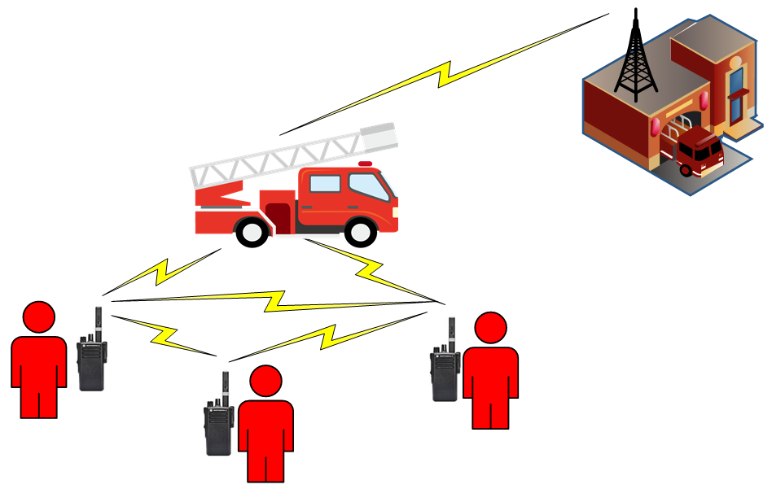
Direct – “Simplex” Radio Communications
Advantage:
Simple and reliable for short range
Disadvantage:
Short Range, only acceptable for smaller buildings

Slide 13
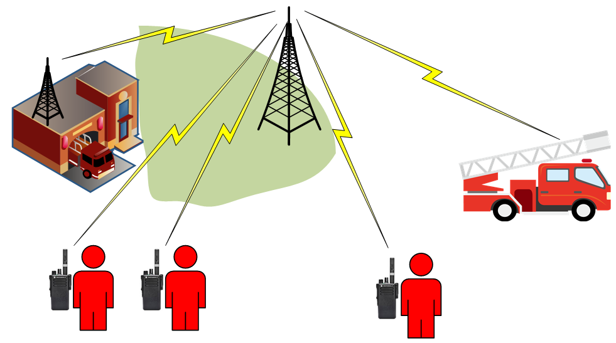
Repeated, “Duplex” Frequency Systems
Advantage:
Good radio signal coverage over a wide area.
RADIO REPEATER SITE
Disadvantage:
Radio signals must reach repeater site to work.

Slide 14
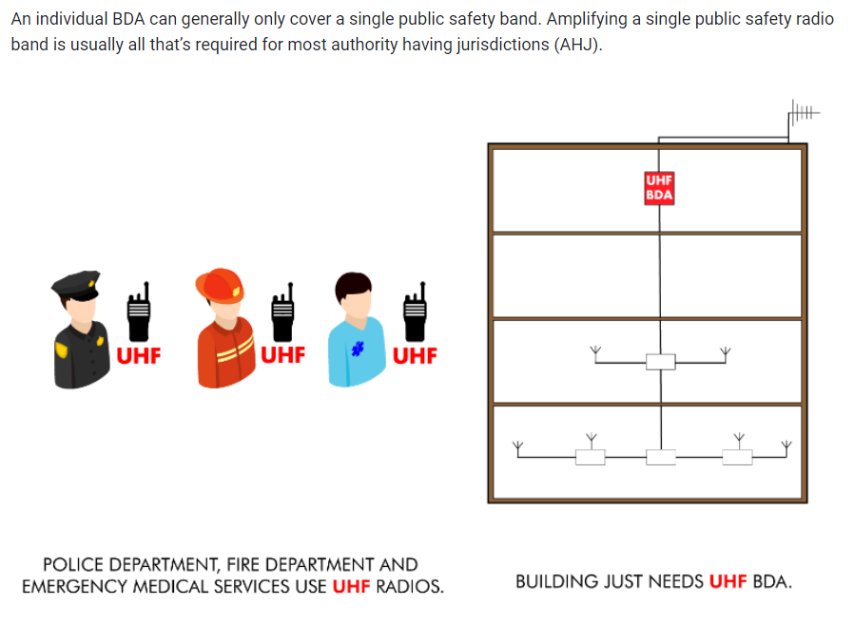

Slide 15
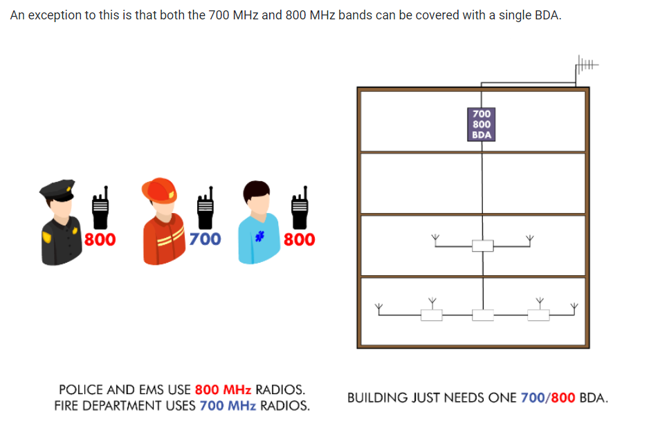

Slide 16
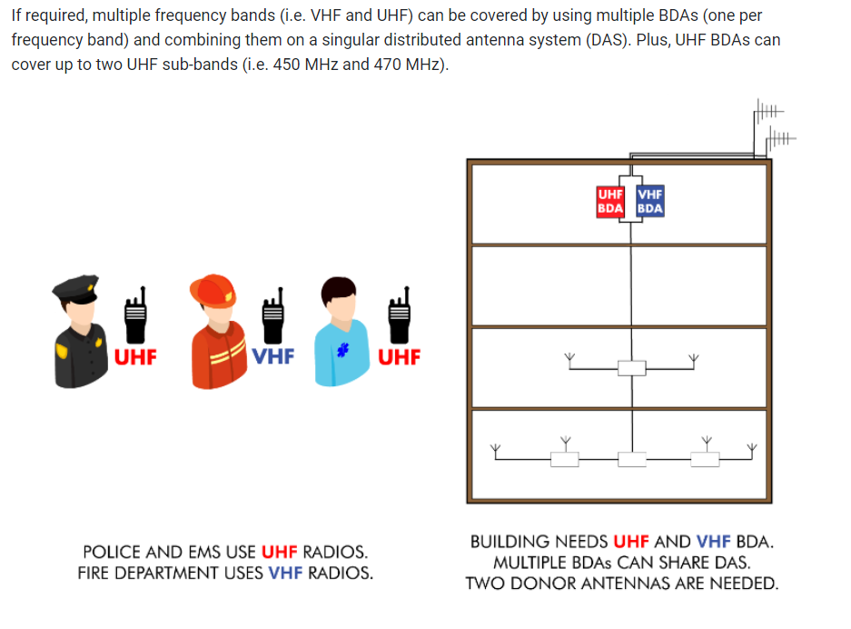

Slide 17
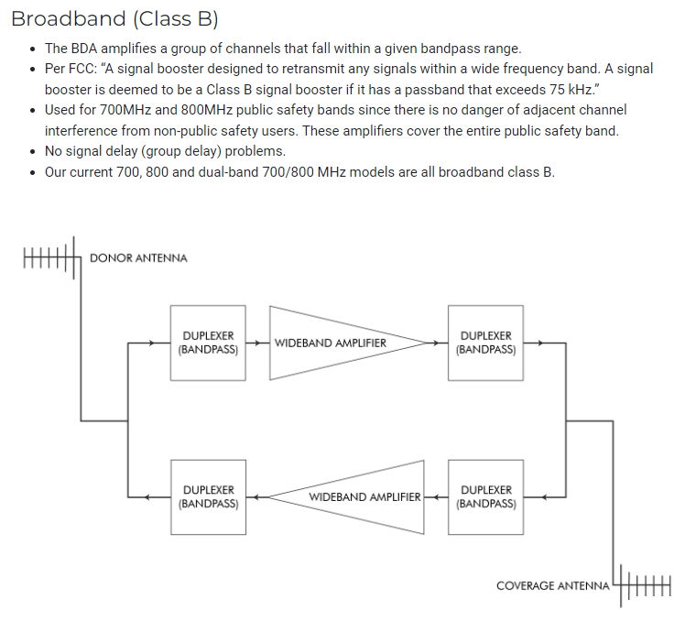

Slide 18
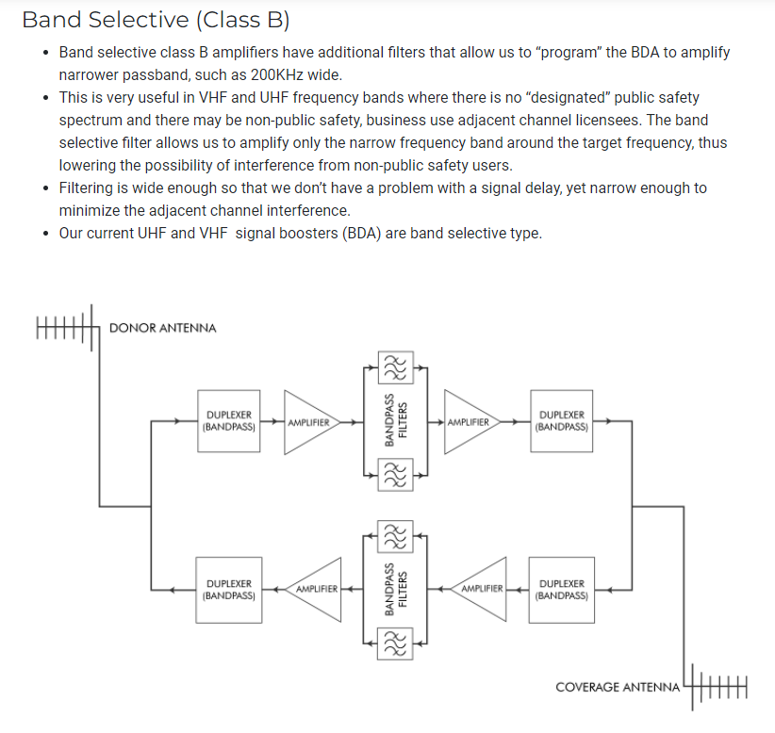

Slide 19
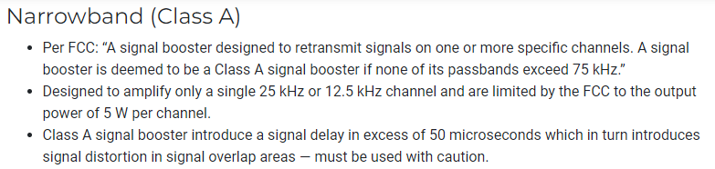
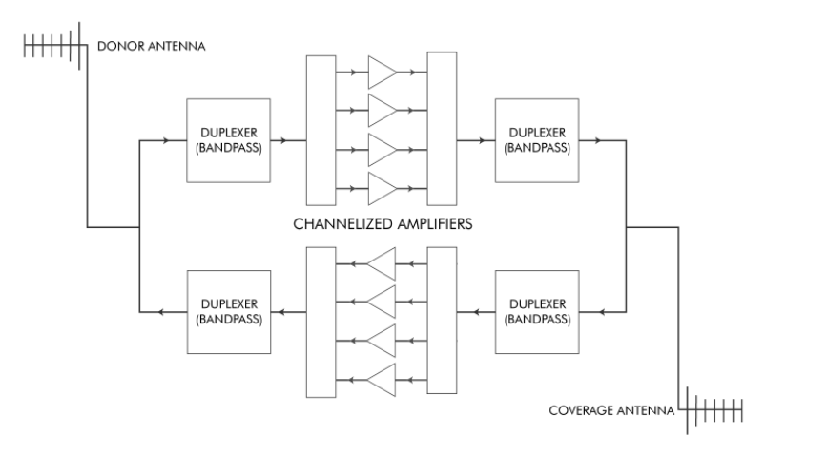

Slide 20

The Problem: In-Building Radio Signal Degradation.
Radio signals are attenuated by:
Concrete, Metal and other building materials
Low-E Glass
Below-Ground Structures
Other obstructions
RF Interference
The consequence:
Poor in-building radio signal coverage and “dead spots”.
Emergency responders lose communications.

Slide 21
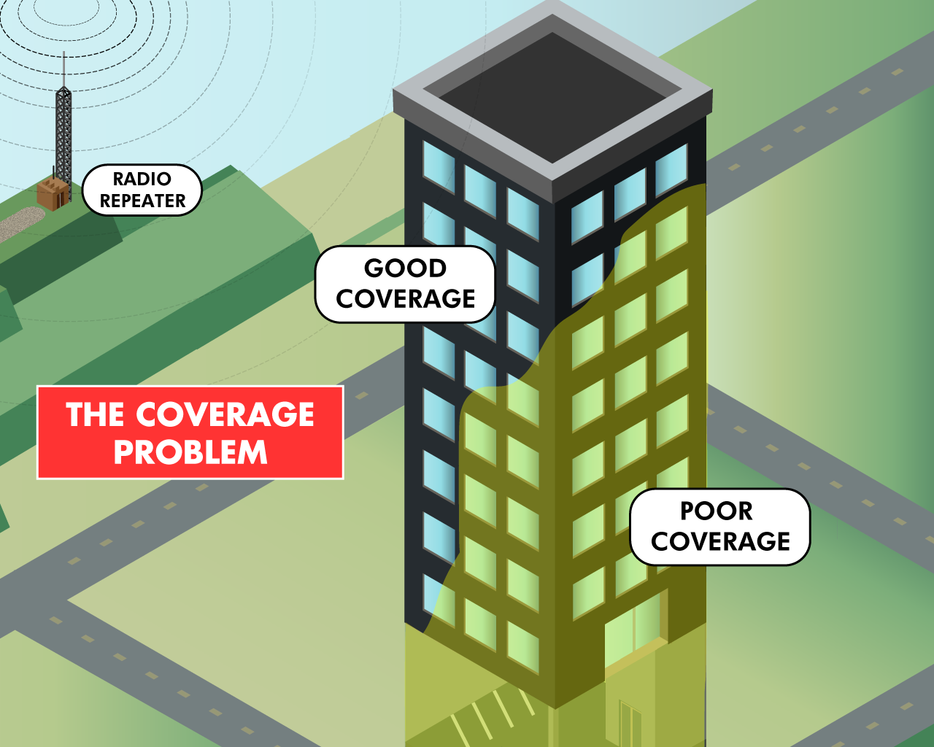
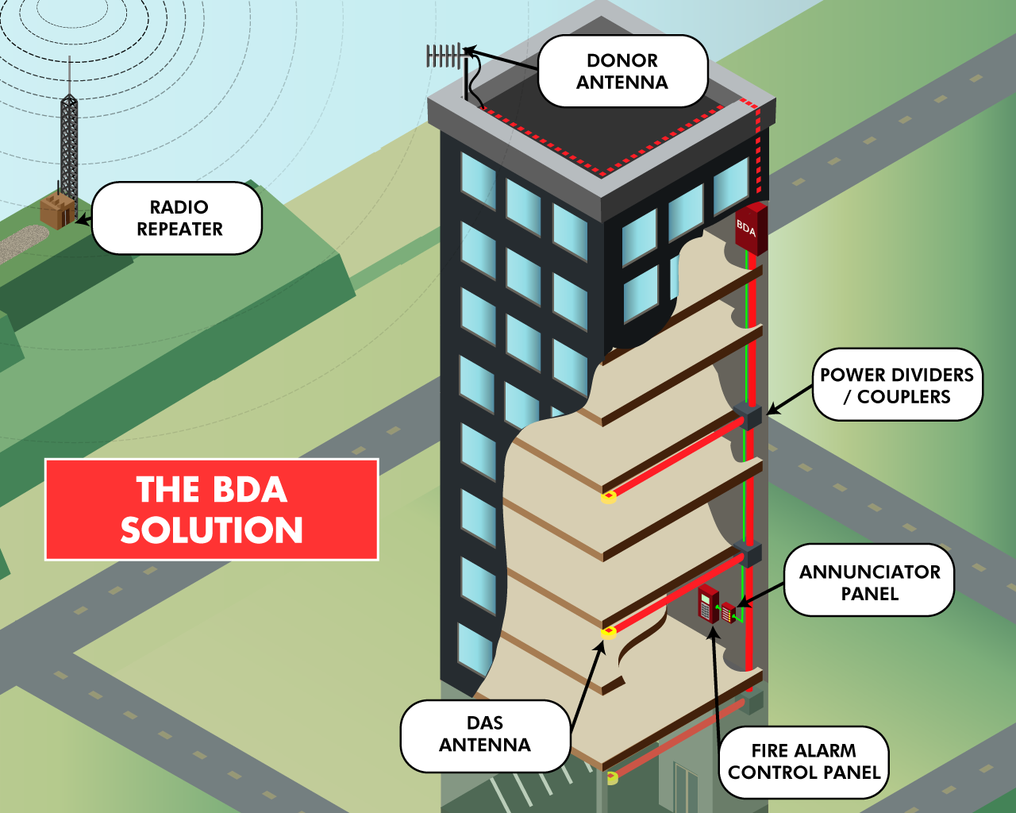
Emergency Responder Communication Enhancement Systems (ERCES)
  Bi-Directional Amplifier (or BDA) System Architecture for ERCES

Slide 22
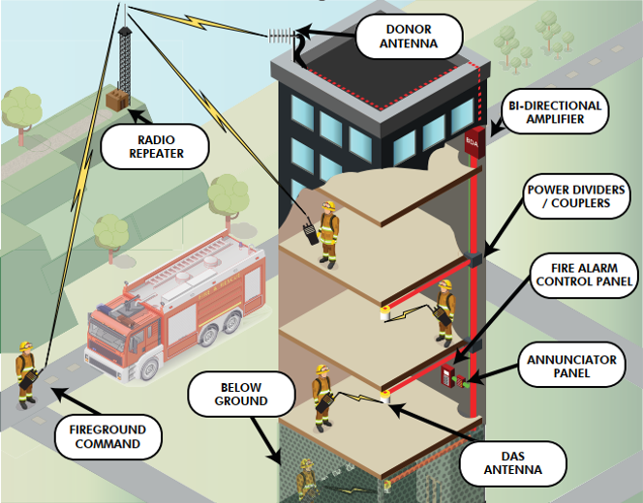
Emergency Responder Communication Enhancement Systems (ERCES)
  Bi-Directional Amplifier (or BDA) System Architecture for ERCES

Slide 23
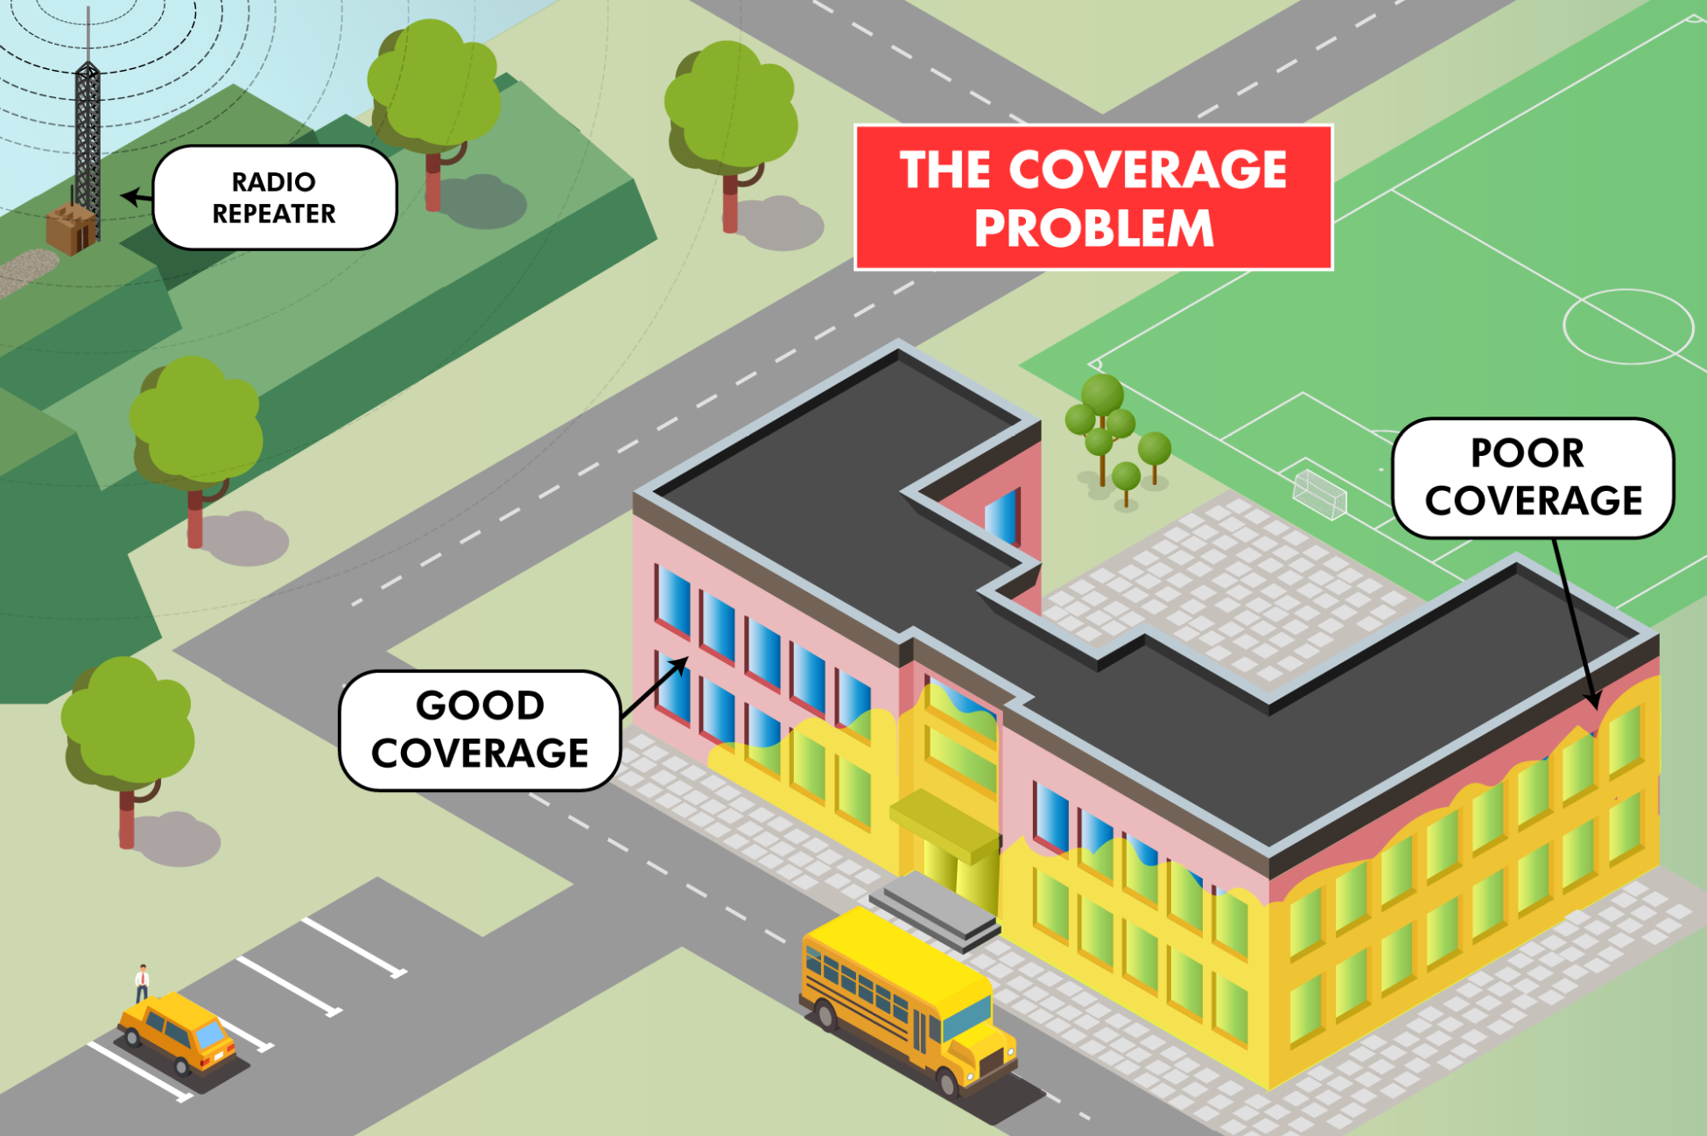
Coverage Problems are NOT just in Highrise Buildings:
Notes:
The part of the School that faces the Radio Communications Site has good RF coverage, but the lower floor and the distant side has poor or no RF coverage

Slide 24
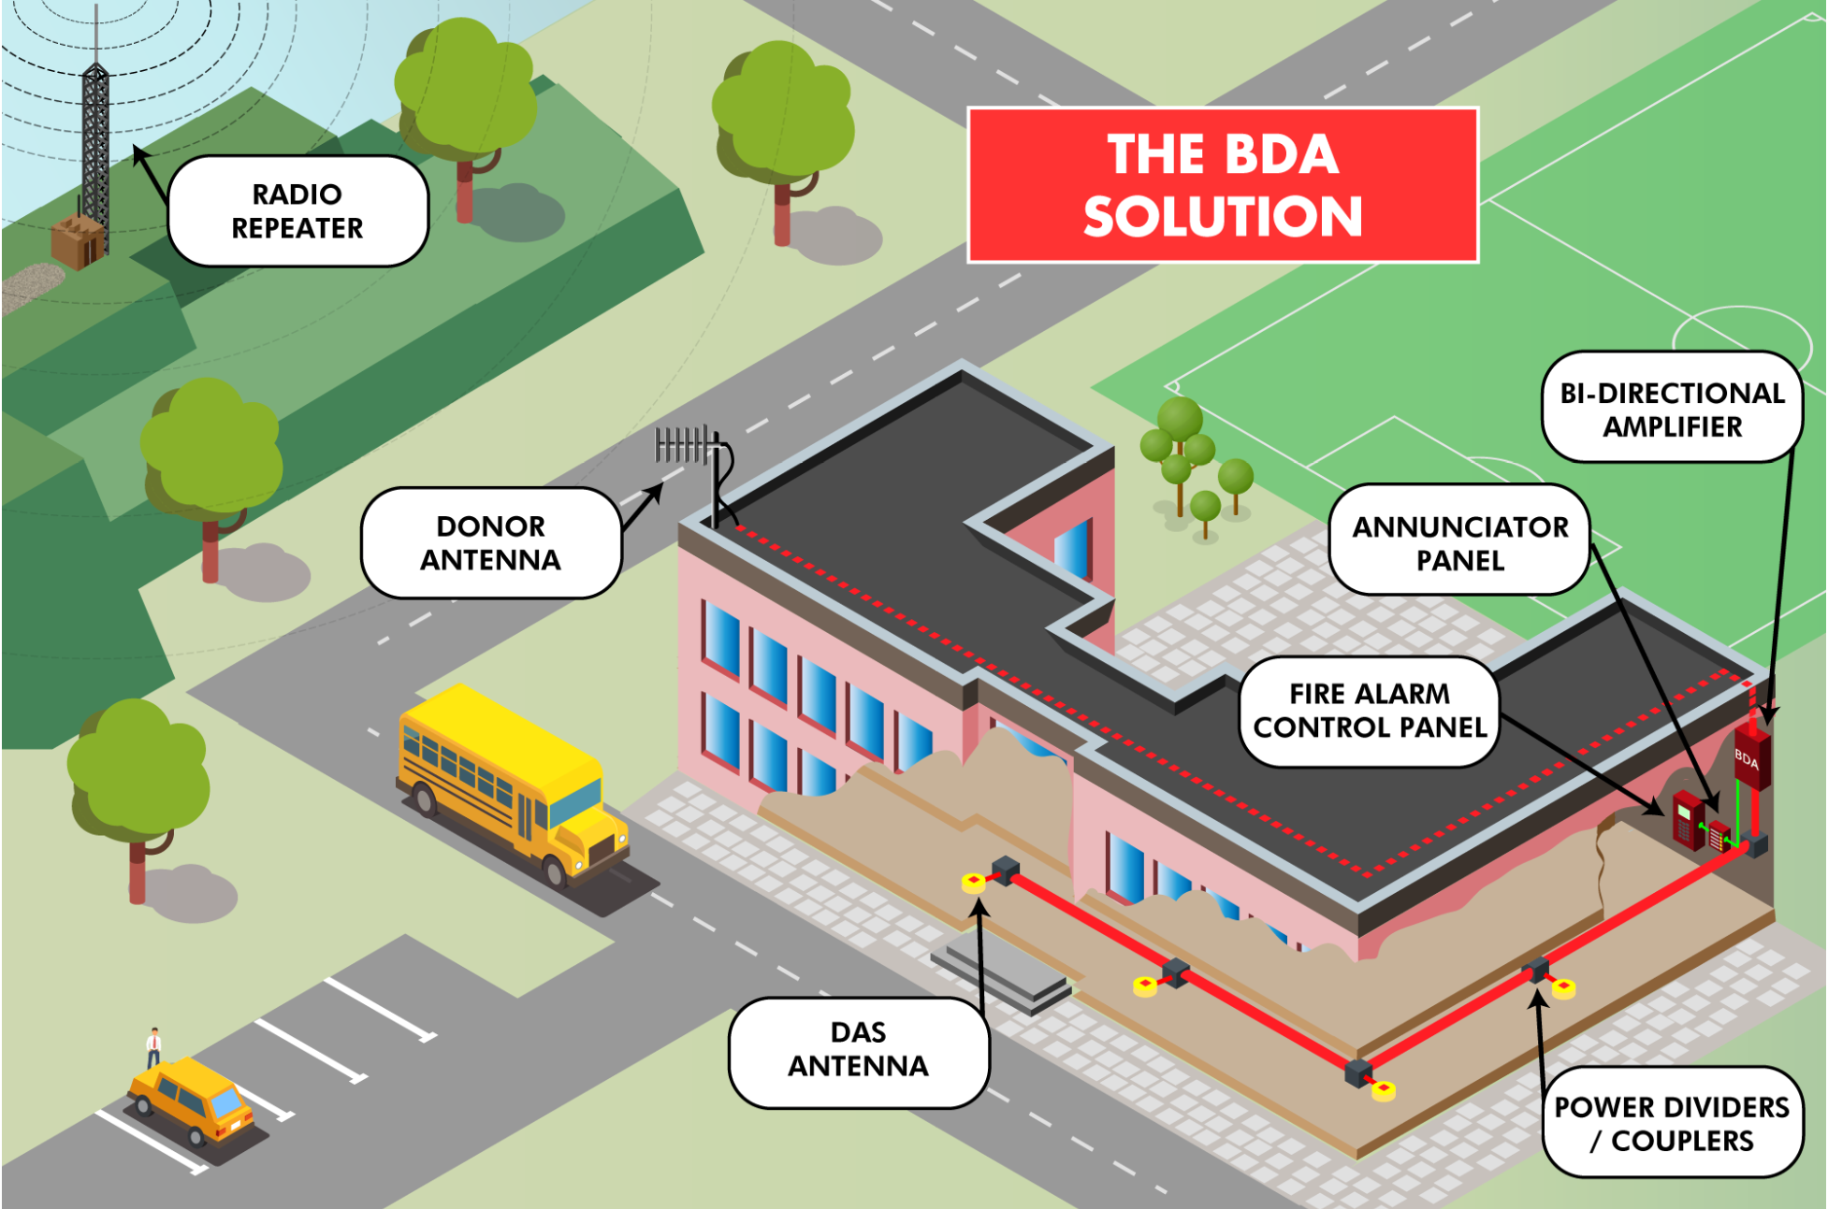
Typical BDA System in a School Building:
Notes:
The donor antenna picks up the radio signal from the Public Safety Radio Repeater and feeds it down into the Bi-Directional Amplifier (BDA) System.
The coax leads to the Bi-Directional Amplifier, which boosts signal through the building using the Distributed Antenna System (consisting of coax, splitters, antennas, etc.) to fill in the areas of the building with insufficient RF coverage.
The first step is to do a signal coverage survey of the school to identify the areas of the school that require signal enhancement.
Slide 32 shows the typical site survey of the 20-grids per floor, and the signal strength must be stronger than -95dBm (on both downlink into the school, as well as uplink).
We can then, after getting the detailed results of the site survey, we can give them the most accurate & cost-competitive price quote if the ERCES / BDA System is required.

Slide 25
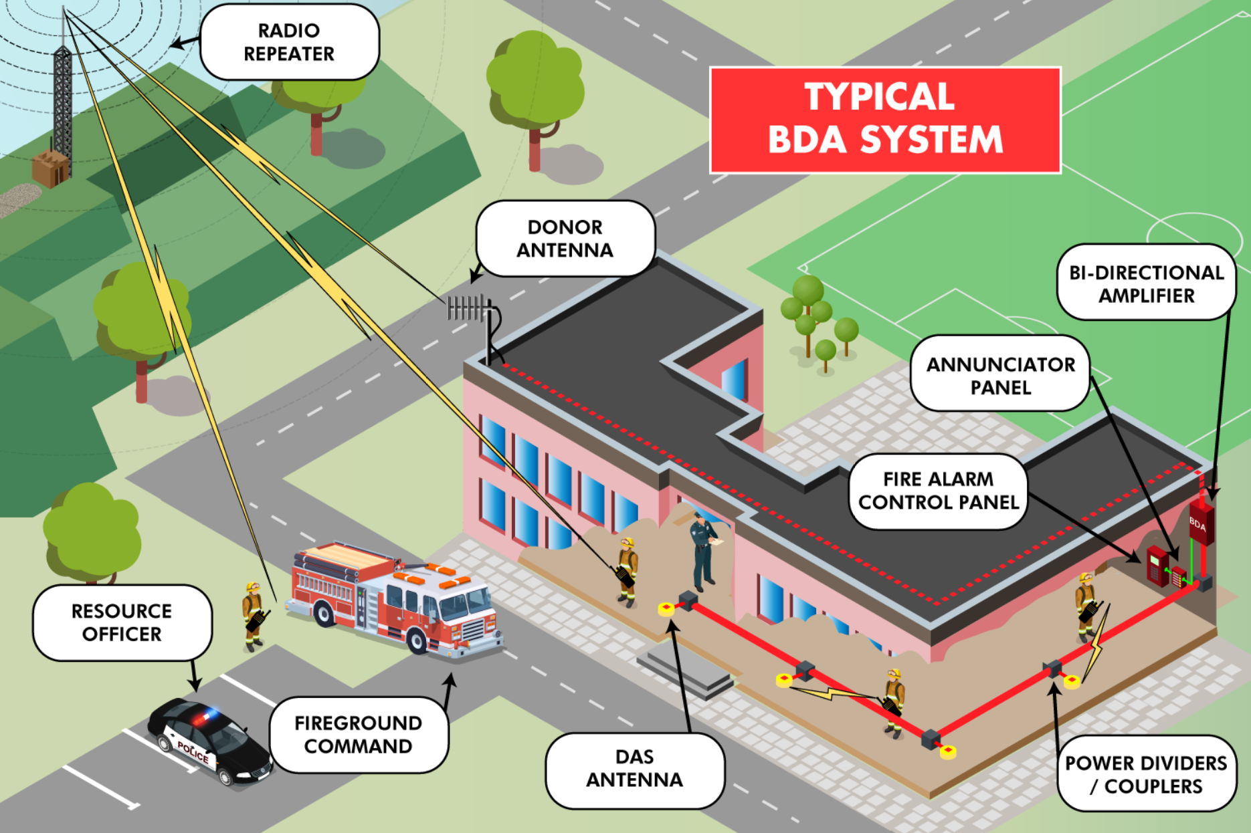
ERCES Are not Just for Fire – Also, Cover Police and EMS:
Notes:
All communications go through the Emergency Radio Repeater

Slide 26
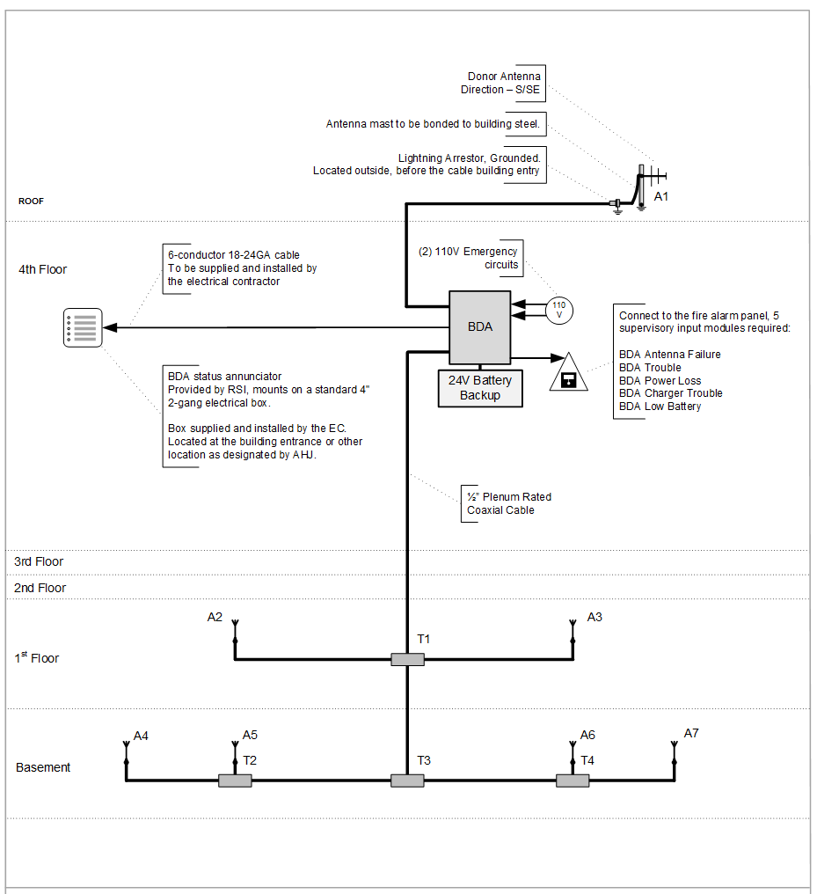
Riser Diagram of a
Typical BDA System
Notes:
Supervision & Monitoring is achieved by the Dedicated Annunciator Panel (comes with the BDA), and remote monitoring by the FACP (using 6 annunciators)

Slide 27
Trivia Question:
Who Invented the Yagi Antenna?

Slide 28
Answer:
Mr. Yagi
Actually, the Yagi-Uda wave projector directional antenna was invented in 1926 by Shintaro Uda under the guidance of Hidetsugu Yagi.

Slide 29
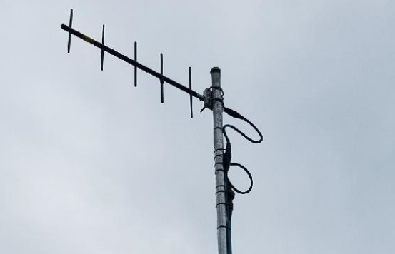
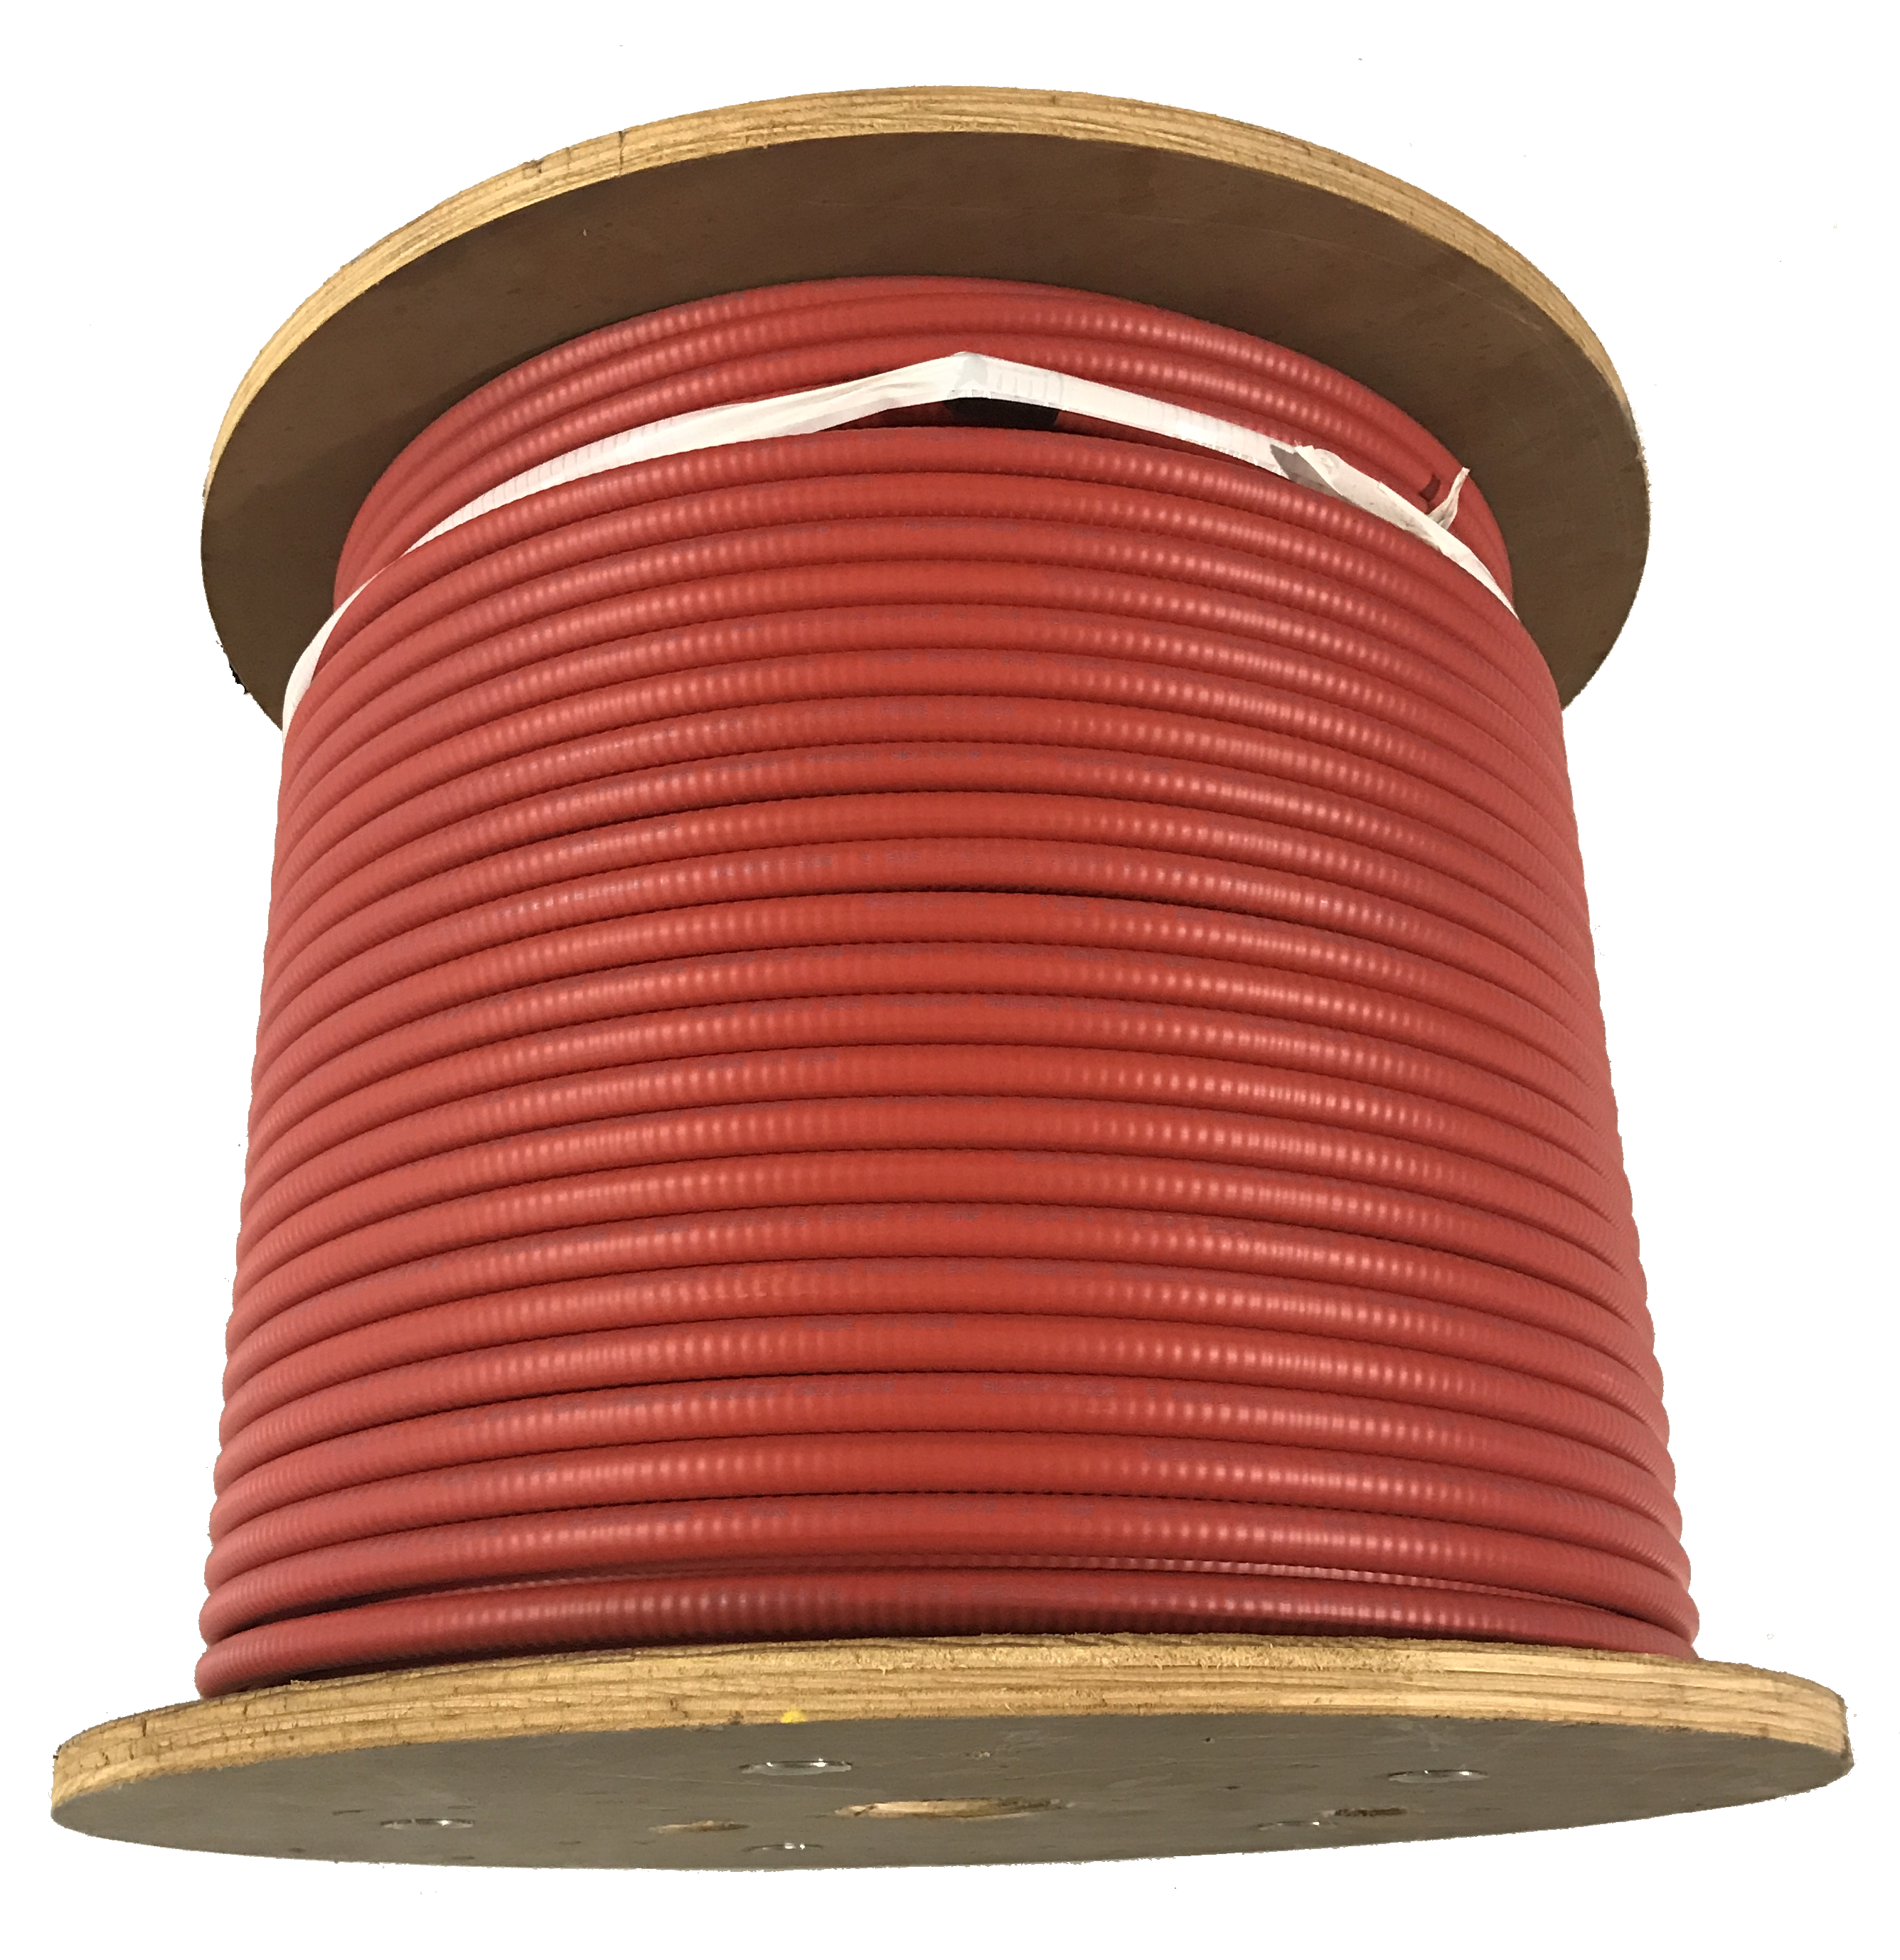
BDA System Components – 1 of 5
Donor Antenna
  Installed on the Roof of the building
  Pointing to the public safety radio
  repeater site
  High gain, high directivity
  Does not need line of sight
Coaxial Cable
  Typically, Plenum Rated, ½” diameter
  Low insertion loss is required
  We now use red cable
  Some AHJs have special labeling requirements

Slide 30

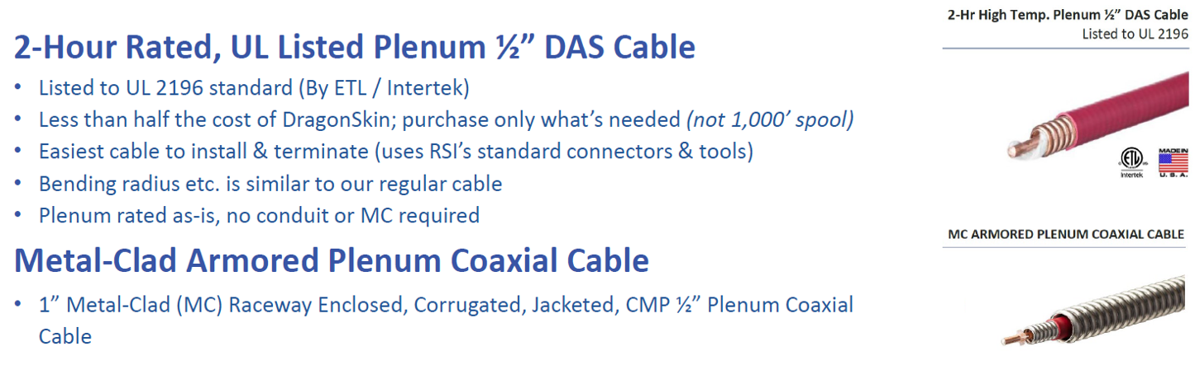

Specialty Cables

Slide 33
Trivia Question:
What temperature is a 2-hour Rated Fire Cable tested at?

Slide 34
Answer:
1850 degrees Fahrenheit (1010 Celsius)
To qualify as a 2-hour fire-rated cable, the cabling must pass the UL 2196 certification. The test involves mounting the cable on a wall and exposing it to a controlled fire where temperatures reach 1850 degrees Fahrenheit for 2 hours. To pass, the cable must maintain circuit integrity and continue to operate electrically throughout.

Slide 35
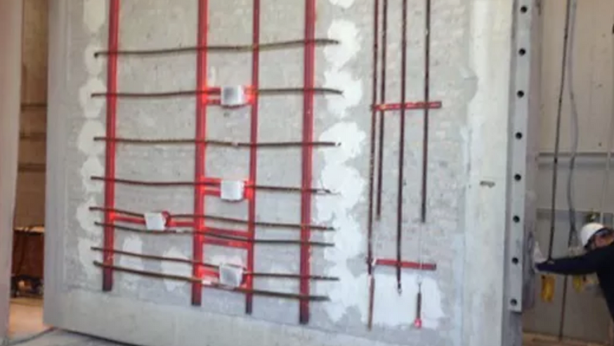

Slide 36
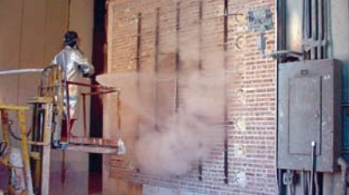

Slide 37
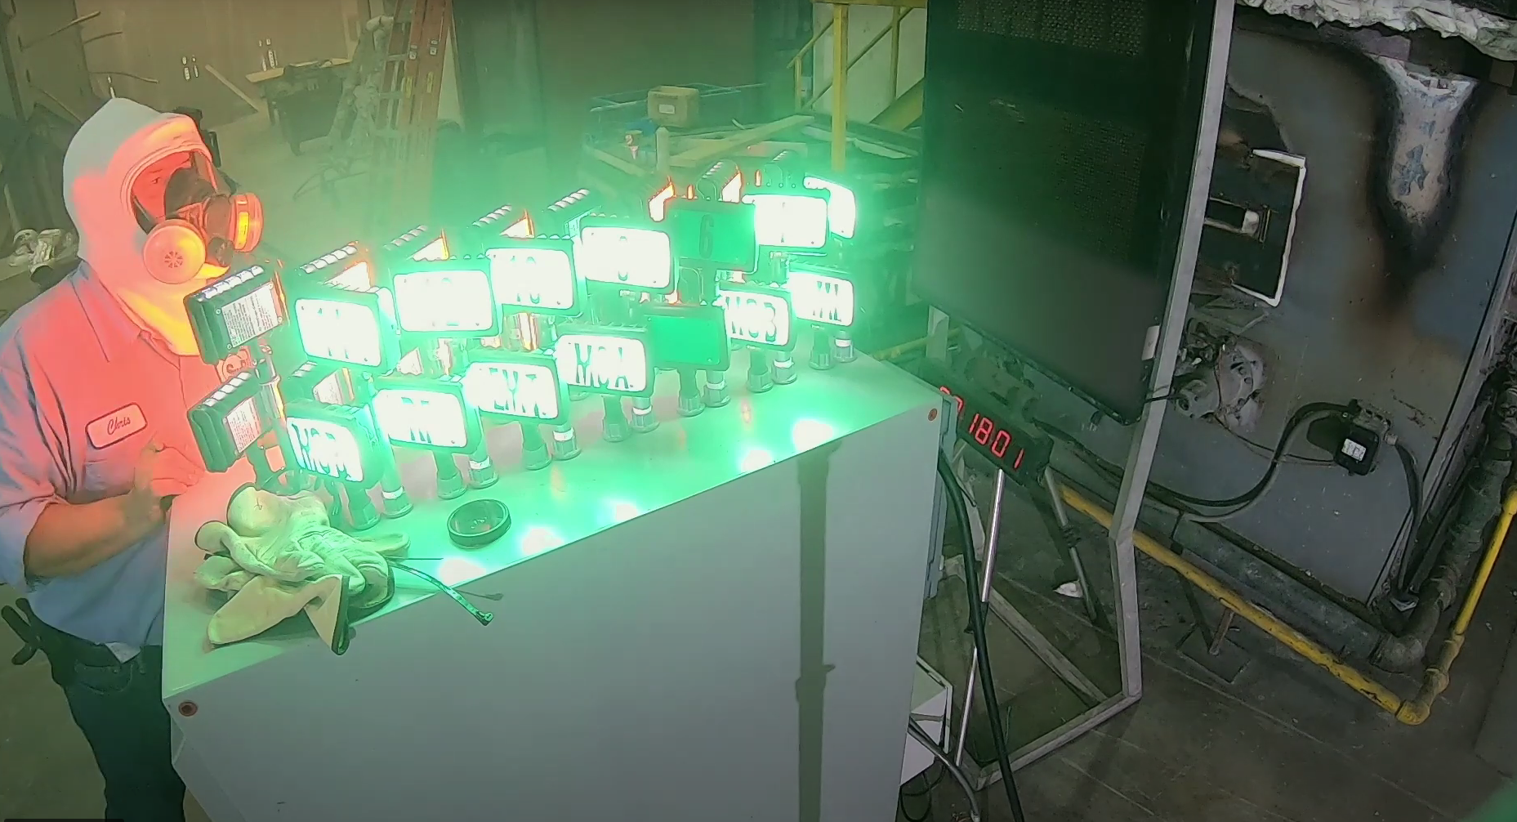

Slide 38
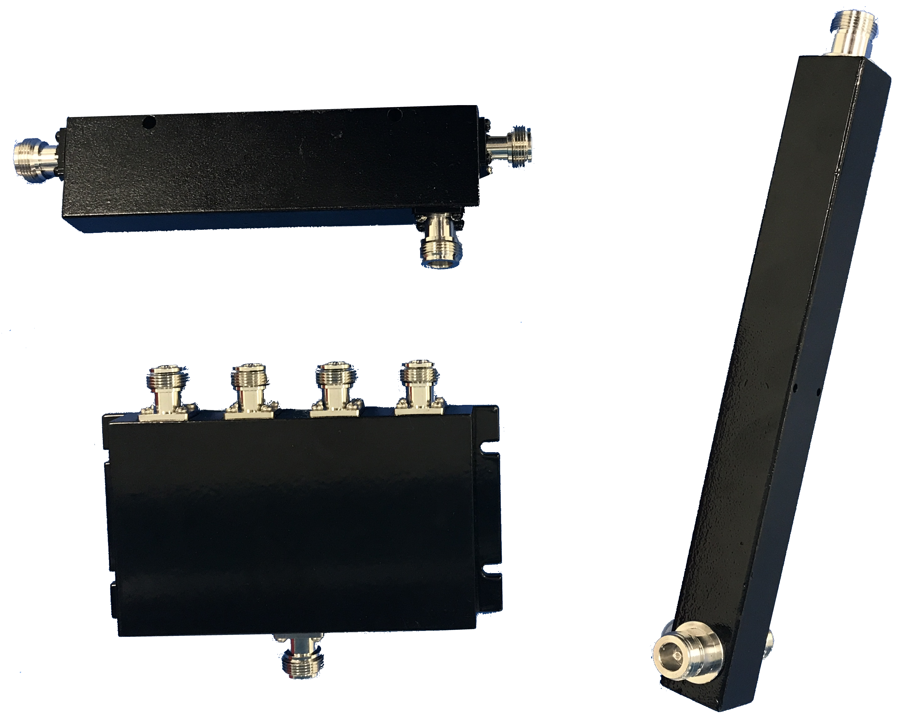
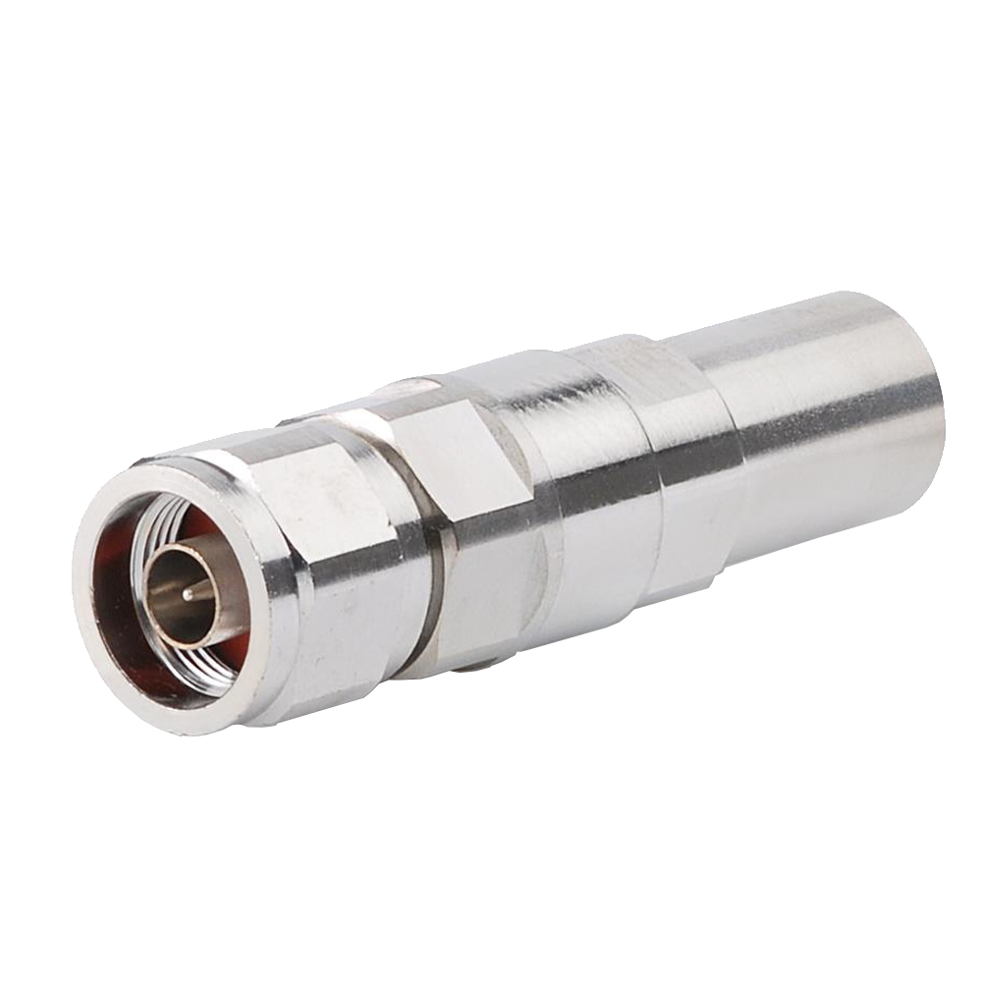
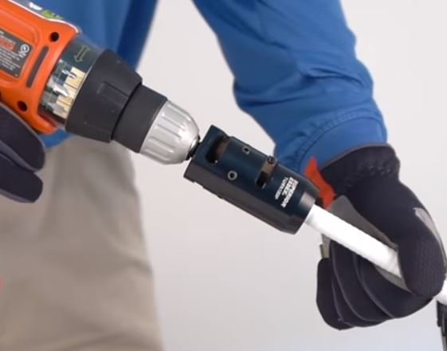
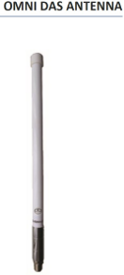
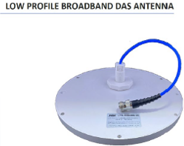
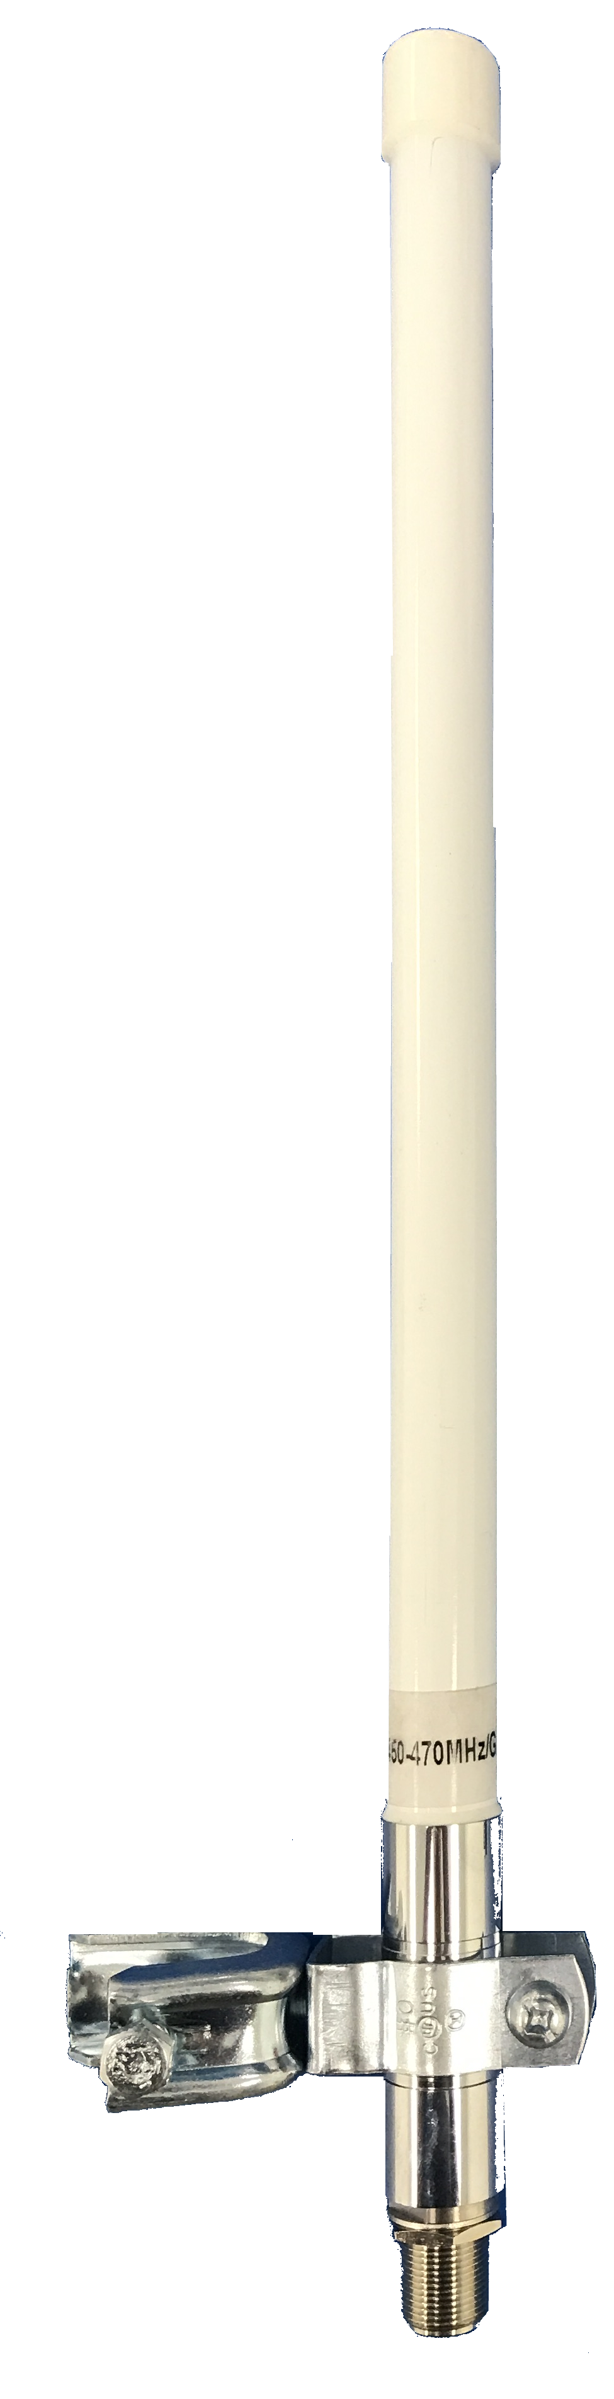
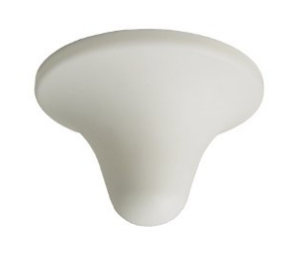
BDA System Components – 2 of 5
Signal Splitters and Couplers
  Used for signal distribution
  Come in different coupling values
RF Connectors
  Installed using specialized tool
  Easily done by a trained technician
DAS Antennas
  Fiberglass “stick” antennas have the best performance
  Other antennas, such as low-profile are available
  Various mounting options are available
Notes:
Typical antenna mounting, similar to smoke detection; requires support

Slide 39
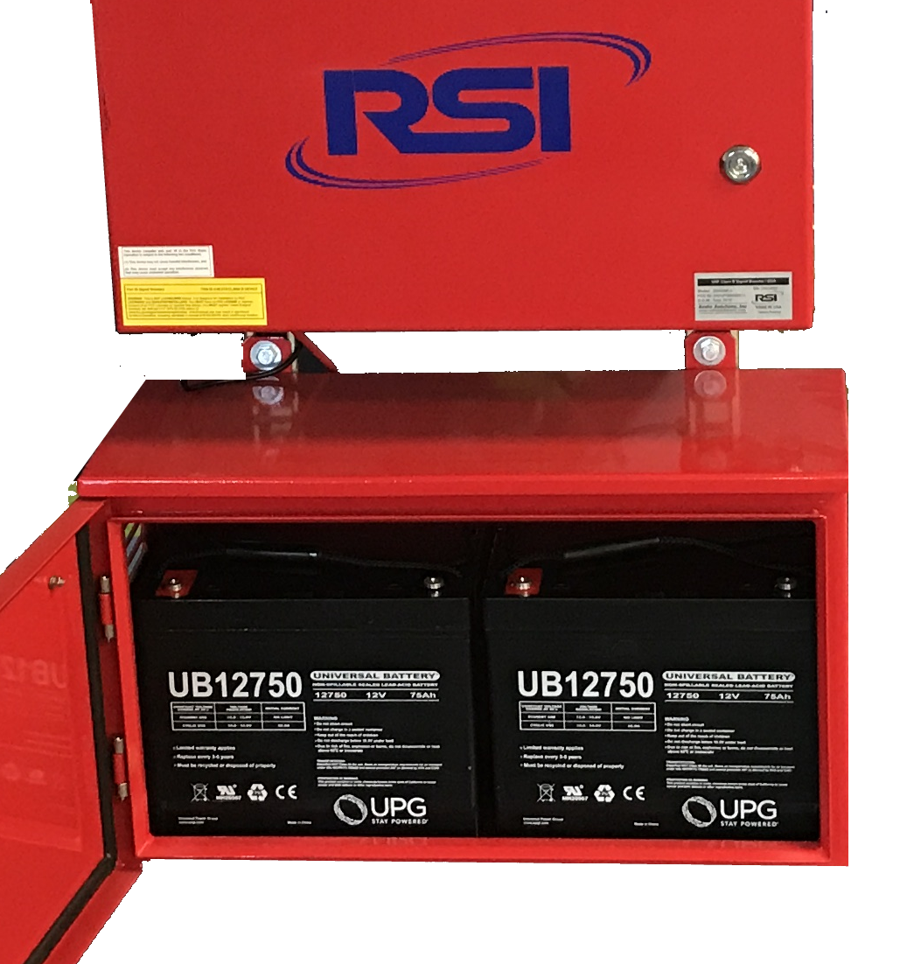
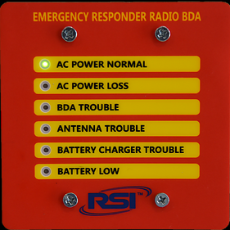
BDA System Components – 3 of 5
Battery Backup
  RSI signal boosters come with a fully integrated
  battery charger and battery diagnostics functions.
  OEM Battery backup enclosure is provided
  with the BDA
  Easy to install, designed to fit below the BDA
Annunciator Panel
  Dedicated monitoring panel is required
  Specified in NFPA-72 and 1221
  Independent from fire alarm system
  Powered by the BDA power supply and battery
  OEM panel included with the BDA
  Easy installation on a standard 2-gang electrical box

Slide 40
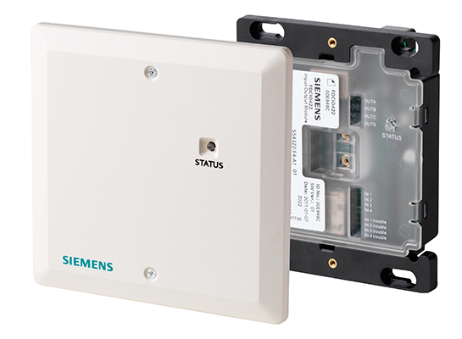
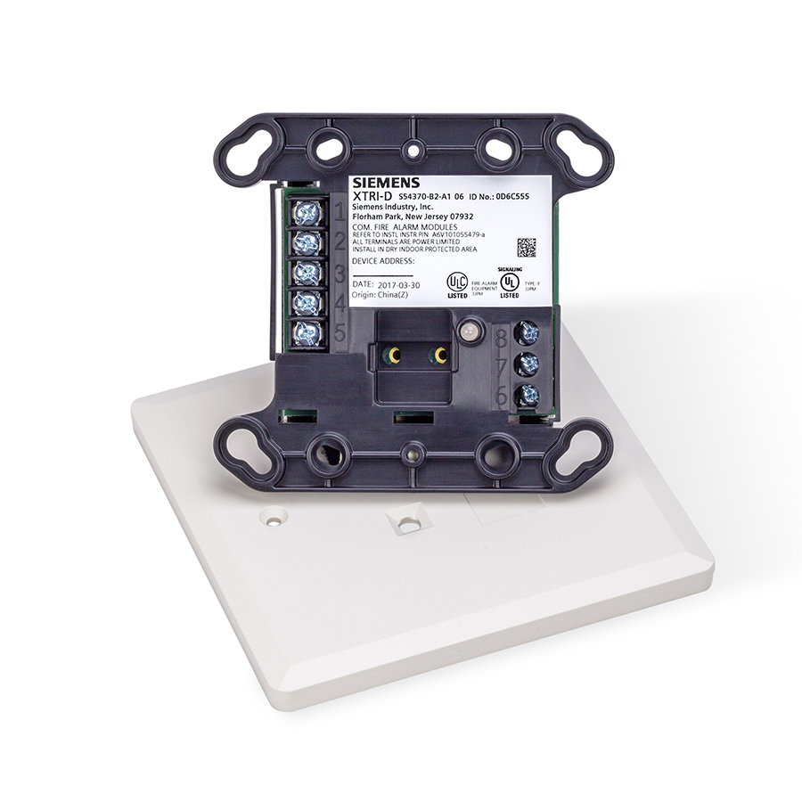
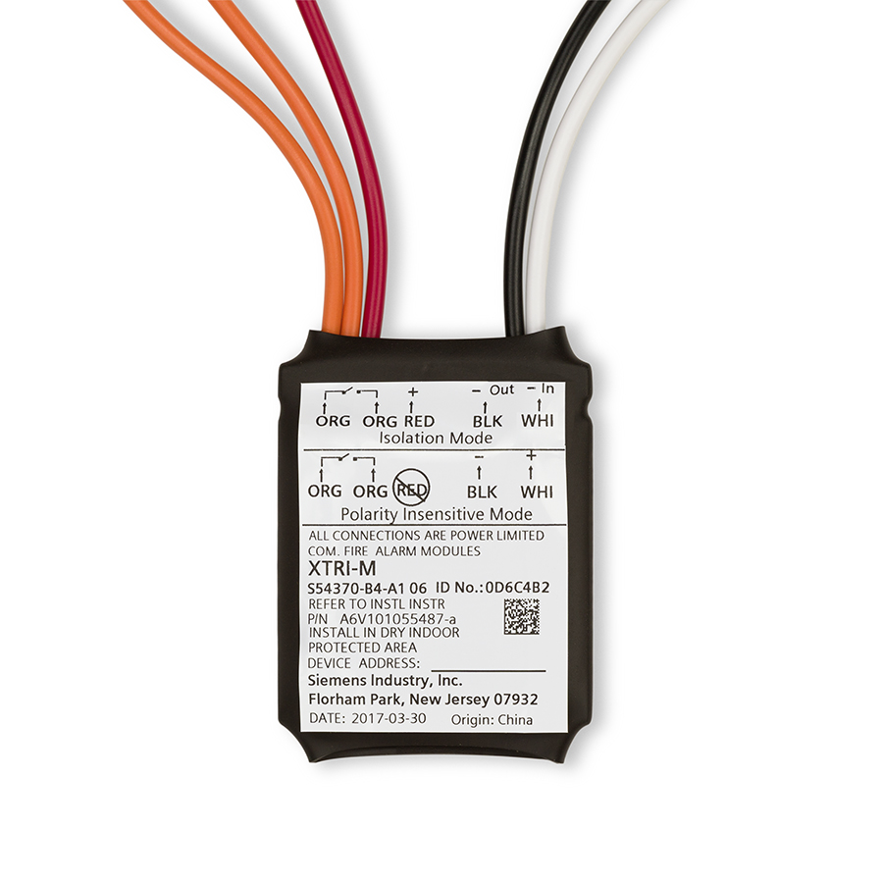
BDA System Components – 4 of 5
Fire Alarm Panel Connection
  BDAs must be monitored by the building’s Fire Alarm System
  Supervisory signals normally include:
    Donor antenna malfunction
    BDA Failure
    Low Battery Capacity
    Loss of normal AC Power
    Failure of a Battery Charger

Slide 41

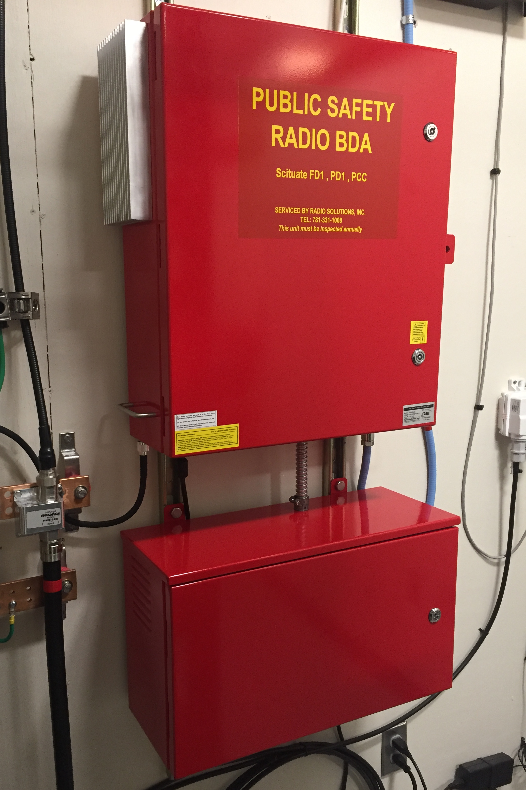
BDA System Components – 5 of 5
BDA (Signal Booster)
  Must meet requirements of the local AHJ.
  Each jurisdiction is different:
    Frequencies / channels required?
      VHF, UHF, 700 or 800MHz, or multi-band?
    Fire only or Fire, Police, EMS, Regional?
    Bandwidth?
    Monitoring Requirements?
    Annunciator Location?
    Labeling Requirements?
    Regulatory Compliance?
    Any other requirements?
  AHJ Specification is the foundation (see the enclosed example spec)
  We can assist!

Slide 42
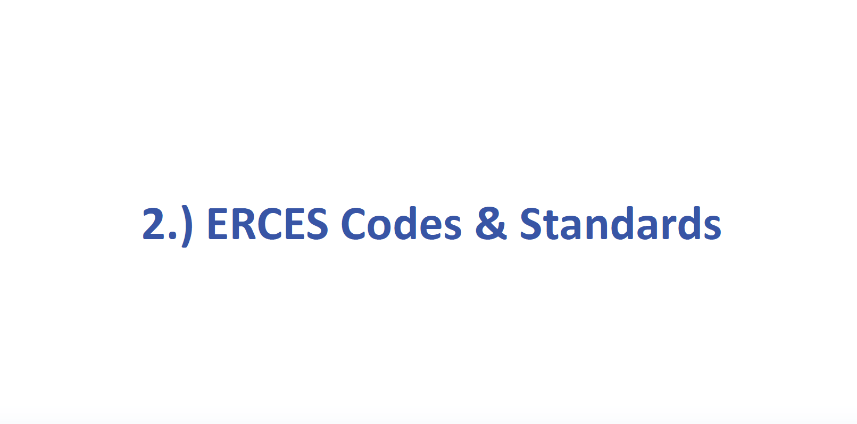

Slide 43
Trivia Question:
What year did BDA / ERCES first appear in our standard code books?
NFPA, IBC, IFC…

Slide 44
Answer:
2006
IBC 2006, 907.2.12.3 Fire department communication system. An approved two-way, fire department communication system designed and installed in accordance with NFPA 72 shall be provided for fire department use.

Slide 45




Code Requirements
IBC 918
IEBC
IFC 510
IFC 907
IFC 1103.2
NFPA 1, 101
NFPA 72
NFPA 1221
NFPA 1225*
Federal
State & Local
Notes:
Texas Local Government Code Chapter 233 (County Regulation of Housing and Other Structures), section 233.062 (Application and Content of Fire Code) permits counties with populations of 250,000 or more or that are adjacent to counties with populations of 250,000 to adopt a fire code. This code must be consistent with the requirements of the International Fire Code as it existed on May 1, 2005, or the Uniform Fire Code as it existed on May 1, 2005.
Under this law, a county may choose between the Uniform Fire Code (NFPA 1) and the International Fire Code. For the correct version of the code for your county, please contact your local government officials.
21 Counties >250K: Harris, Dallas, Tarrant, Bexar, Travis, Collin, Denton, Hidalgo, El Paso, Fort Bend, Montgomery, Williamson, Cameron, Brazoria, Bell, Nueces, Galveston, Lubbock, Webb, McLellan, Jefferson,

Slide 46
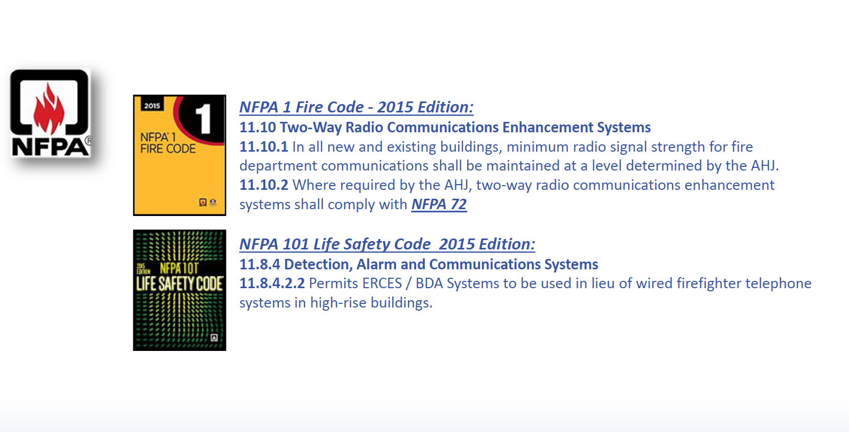

Slide 47
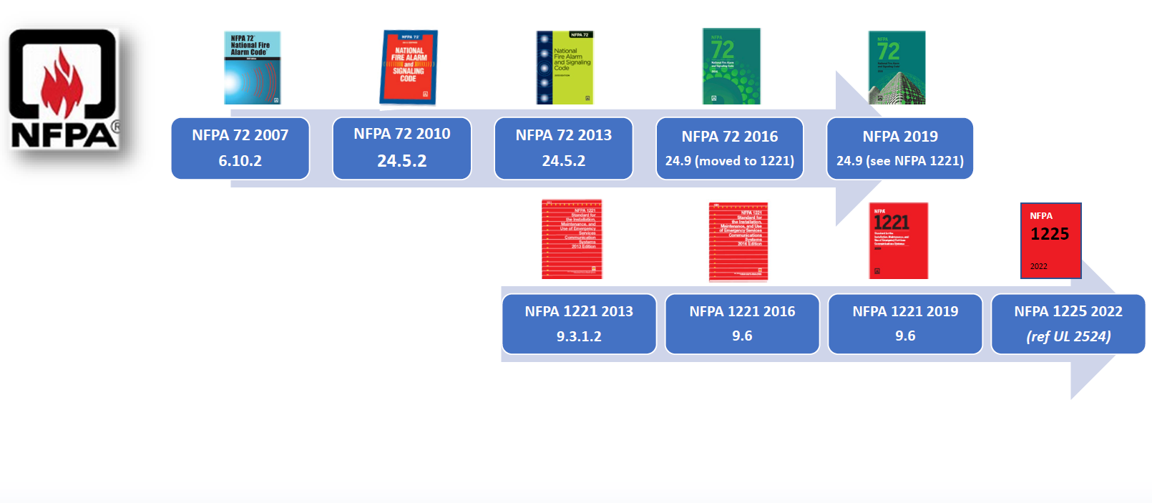
ERCES Codes and Standards

Slide 48
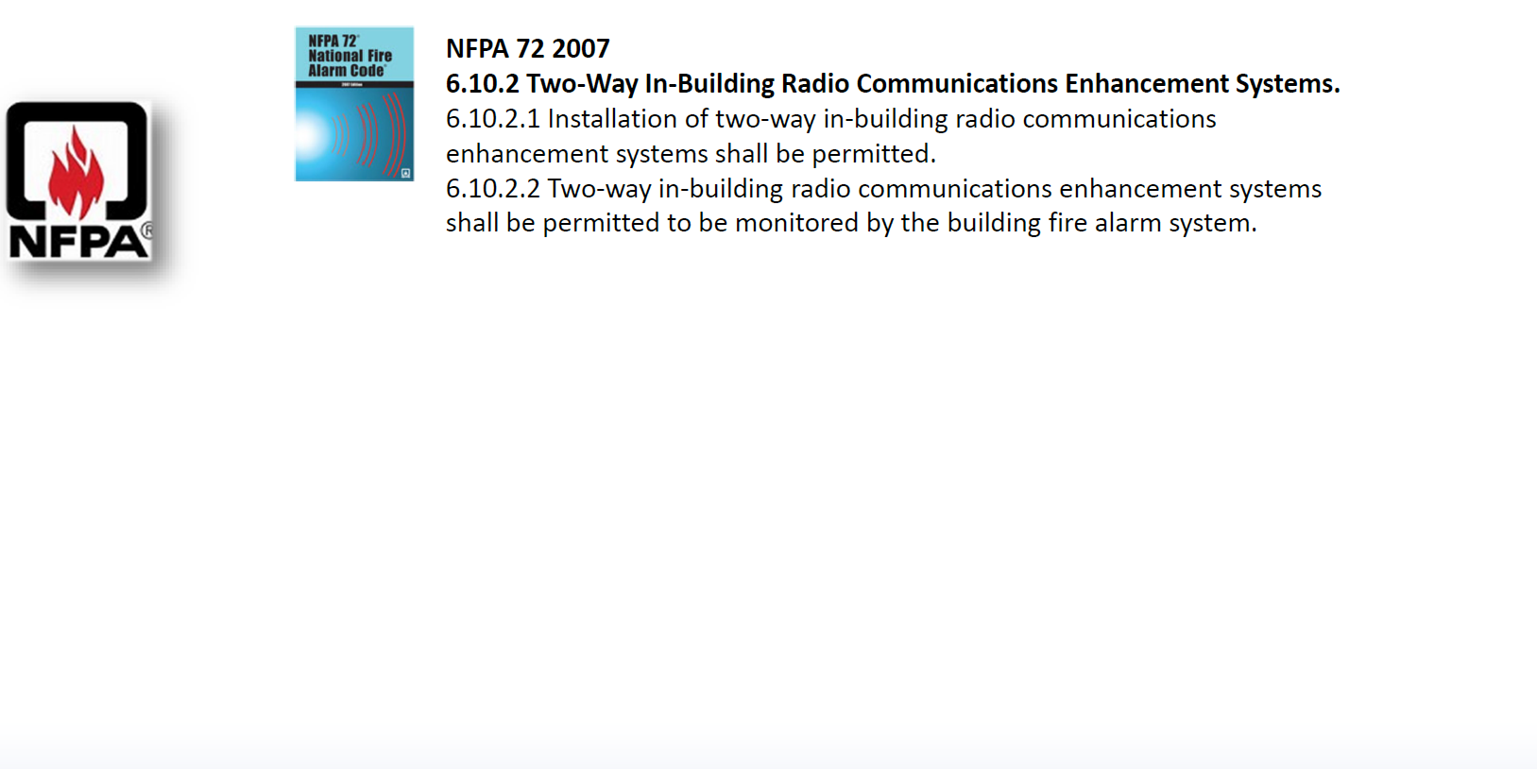

Slide 49
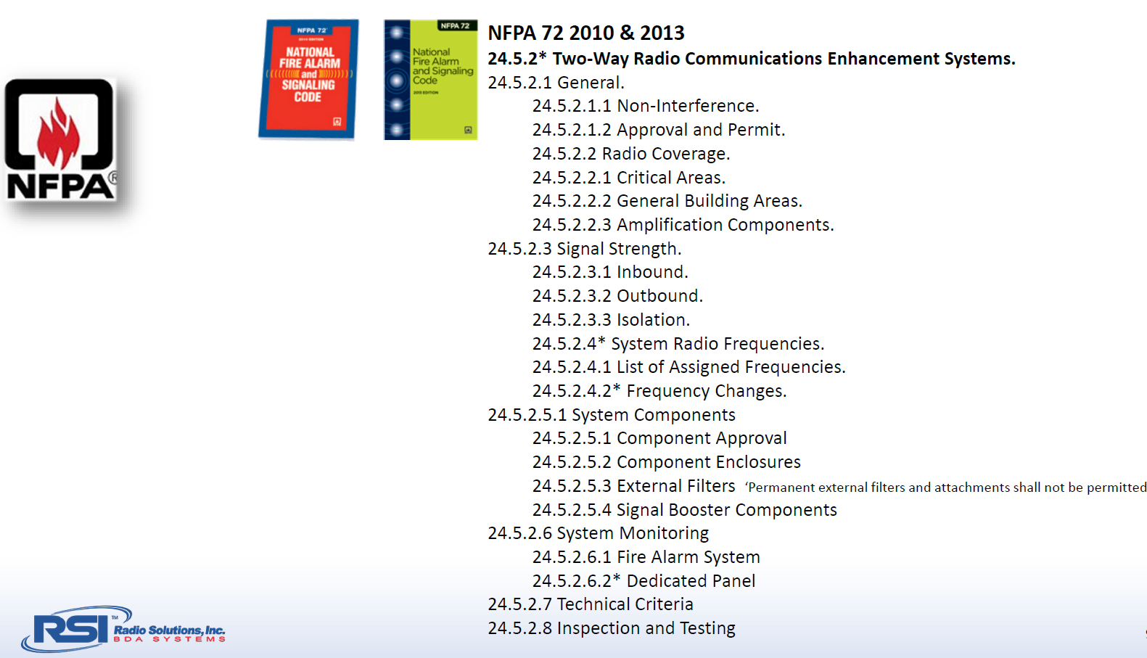

Slide 50
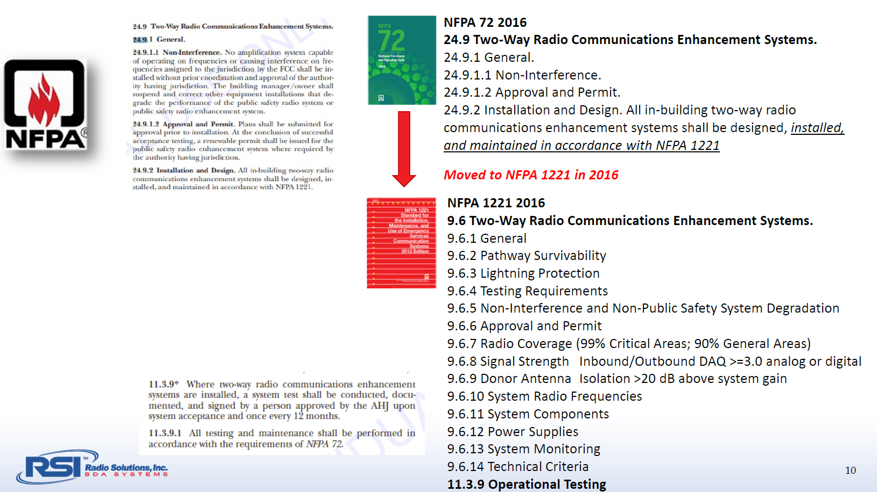

Slide 51


Slide 52


Slide 53


Slide 54


Slide 55


Slide 56


Slide 57


Slide 58


Slide 59


Slide 60


Slide 61


Slide 62


Slide 66


Slide 67


Slide 68




Slide 69


Slide 70


Slide 71


Slide 72


Slide 73

NOT All “Listings” Are The Same
LISTED BDA?
Only the enclosure is properly listed

Slide 74


Slide 75





What About Code Compliance, Reliability and Product Safety?

Slide 76


Battery Backup
… no worries

Slide 77

Built for … code compliance?

Slide 78


Slide 79
Trivia Question:
What is by far the top concern that most AHJs have about non-compliant BDA / ERCES?

Slide 80
Answer:
Oscillation Interference
Improper installation or a failure could lead to Oscillation creating interference to the Public Safety Radio System.

Slide 81


Slide 82



Slide 83




Slide 84


Slide 85



Slide 86


Slide 87


Slide 88


Slide 89


Slide 90


Slide 92


Slide 93


Slide 94


Slide 95


Slide 96

E.R.C.E.S. Specification from City of San Antonio
SECTION 510 EMERGENCY RESPONDER RADIO COVERAGE is amended as follows:
510.1 Emergency responder radio coverage in new buildings. Except as otherwise provided, no person shall erect, construct, or modify any building or structure or any part thereof, or cause the same to be done which fails to support adequate radio coverage for City of San Antonio public safety services including, but not limited to, police, fire, and public works departments. A certificate of occupancy may not be issued for any building or structure which fails to comply with this requirement. The frequency range which must be supported shall be 800 MHz range or as otherwise established and required in writing by the City of San Antonio as being necessary for public safety purposes.
510.11 Exemptions. This section shall not apply to buildings less than 50,000 square feet or any single-family detached residential dwelling or multifamily building or structure less than 50,000 square feet or any building under four stories with less than 50,000 square feet per floor.

Slide 97

E.R.C.E.S. Specification from the City of Austin
510.1 Emergency responder radio coverage in buildings. All buildings shall have approved radio coverage for emergency responders within the building based upon the existing coverage levels of the public safety communications system of the jurisdiction at the exterior of the building. This section shall not require improvement of the existing public safety communication system. Exceptions: Page 37 of 93 1. Where approved by the building official and the fire chief, a wired communication system in accordance with Secton 907.2.13.2 shall be permitted to be installed or maintained in lieu of an approved radio coverage system in buildings where a floor for human occupancy is located not more than 75 feet (22 860 mm) above the lowest level of fire department vehicle access. 2. Where it is determined by the fire code official that the radio coverage system is not needed.
510.1.1 Time Frame for New Building Installations. The adequacy of radio coverage for buildings permitted after adoption of this code shall be determined following completion of construction and issuance of the Certificate of Occupancy. If supplemental equipment such as bi-directional amplifiers are necessary to assure radio coverage, the design and installation of the supplementary radio transmission equipment shall be completed within two years of original occupancy.
510.1.2 Time Frame for Existing Buildings. If it is discovered that radio coverage is not adequate within buildings permitted prior to the adoption of this code, the design and installation of necessary supplementary radio transmission equipment shall be completed within three years of the discovery of the deficiency.

Slide 98

E.R.C.E.S. Specifications from Harris County
SECTION 510 – 2018 IFC EMERGENCY RESPONDER RADIO COVERAGE 510.1
Emergency responder radio coverage in new buildings. New buildings shall have approved radio coverage for emergency responders within the building based on the existing coverage levels of the public safety communication systems utilized by the jurisdiction, measured at the exterior of the building. Coverage shall include the Harris County Radio System (TxWARN). The frequency range to be supported is 700-800 MHz (FDMA and TDMA)). Additional VHF/UHF (150-174 MHz/408-512 MHz) frequency range may be required based upon the need of local public safety services or as otherwise required in writing by Harris County for public safety purposes. Any building or structure that fails to support adequate radio coverage must be brought into compliance. The owner shall immediately contact the Harris County Fire Marshal’s Office to report the system failure. This section shall not require improvement of the existing public safety communication systems.
Exceptions:
1. Where it is determined by the fire code official that the radio coverage system is not needed.
2. Buildings less than 50,000 square feet.
3.Single-family detached residential dwellings and multifamily buildings.
4. Any building less than four stories in height with less than 50,000 square feet per floor.
510.2 Emergency responder radio coverage in existing buildings. Existing buildings shall be provided with approved radio coverage for emergency responders as required in Chapter 11.

Slide 99

E.R.C.E.S. Specifications from the City of Houston
The Houston Construction Code requires Emergency Responder Radio Coverage (ERRC) in all buildings. The Houston Fire Department (HFD) and Building Code Enforcement (BCE) initiated a practice of compliance verification, effective June 6, 2018. In all new buildings and existing building remodel plans, the code analysis sheet is now required to include information from the designer acknowledging that the facility will comply with all applicable code provisions for ERRC, as required by Sections 914 and 510 of the current Houston Adopted Building and Fire Codes, respectively. Prior to issuing the Certificate of Occupancy (CO), facilities not otherwise exempted by PART 2 below, shall be tested by a City of Houston registered ERRC third-party special inspector using appropriately trained personnel. A copy of the special inspection report documenting ERRC compliance with the Houston Fire Code, shall be submitted to BCE at the following email address for review: HPC-RA@houstontx.gov.
PART 1 – MINIMUM QUALIFICATIONS OF ERRC DESIGNER, INSTALLER AND SPECIAL INSPECTOR TESTING PERSONNEL
PART 2 – ERRC PLAN REVIEW AND SPECIAL INSPECTION EXEMPTIONS
PART 3 – PLAN REVIEW SUBMITTAL PROCESS
PART 4 – DEFERRED SUBMITTAL ERRC PLAN REVIEW
PART 5 – HOUSTON HITS – RADIO COMMUNICATION SERVICES CONTACT AND ERRC FREQUENCIES

Slide 100


Slide 101


Slide 102


Slide 103


Slide 104


Slide 105



Slide 106

  iBwave Predictive RF Model Shows Coverage Heat Map

Slide 107

Questions Anyone?
David Garnaat
Territory Sales Manager / AR. TX. LA.
Siemens Fire Alarm Products
Phone: 479-262-4896
Email: david.garnaat@siemens.com
siemens.com

Slide 108
Disclaimer
Subject to changes and errors. The information given in this document only contains general descriptions and/or performance features which may not always specifically reflect those described, or which may undergo modification in the course of further development of the products. The requested performance features are binding only when they are expressly agreed upon in the concluded contract.
All product designations, product names, etc. may contain trademarks or other rights of Siemens AG, its affiliated companies or third parties. Their unauthorized use may infringe the rights of the respective owner.

